Slide 1
Lecture 5: Linear Regression, kNN Regression and Inference

Slide 2
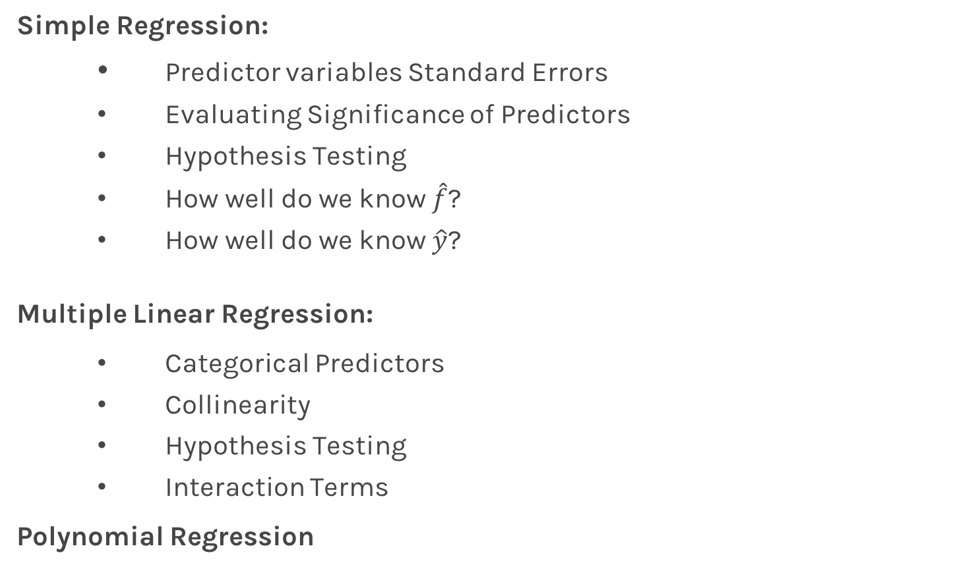
Lecture Outline
Simple Regression:
Predictor variables Standard Errors
Evaluating Significance of Predictors
Hypothesis Testing
How well do we know $\hat{f}$?
How well do we know $\hat{y}$?
Multiple Linear Regression:
Categorical Predictors
Collinearity
Hypothesis Testing
Interaction Terms
Polynomial Regression

Slide 3
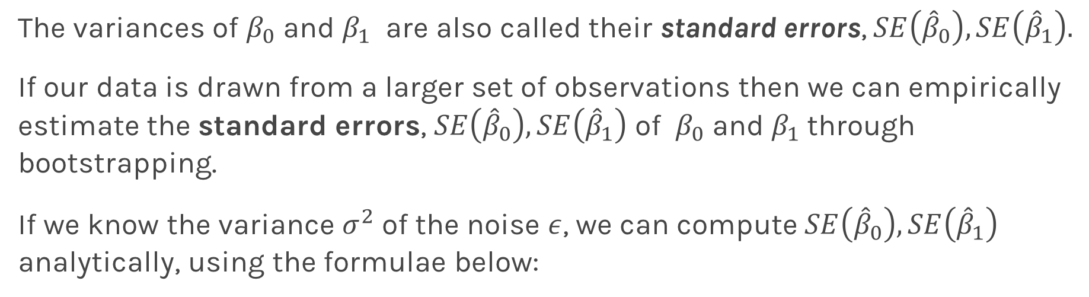
Standard Errors
The variances of $β_{0}$ and $β_{1}$ are also called their standard errors, $SE\left({\hat{β}}_{0}\right),SE\left({\hat{β}}_{1}\right).$
If our data is drawn from a larger set of observations then we can empirically estimate the standard errors, $SE\left({\hat{β}}_{0}\right),SE\left({\hat{β}}_{1}\right)$ of $β_{0}$ and $β_{1}$through bootstrapping.
If we know the variance $σ^{2}$ of the noise $ε$, we can compute $SE\left({\hat{β}}_{0}\right),SE\left({\hat{β}}_{1}\right)$ analytically, using the formulae below:

Slide 4
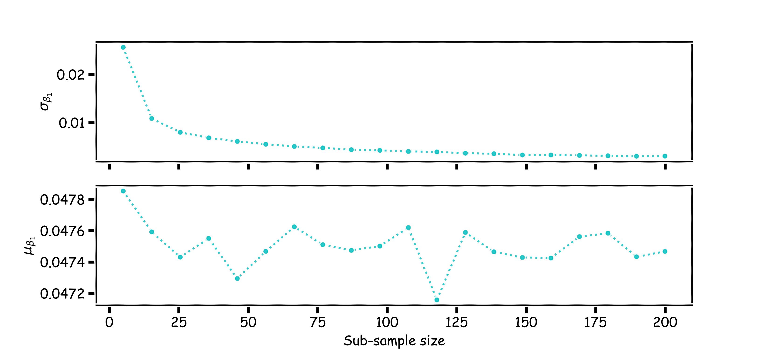
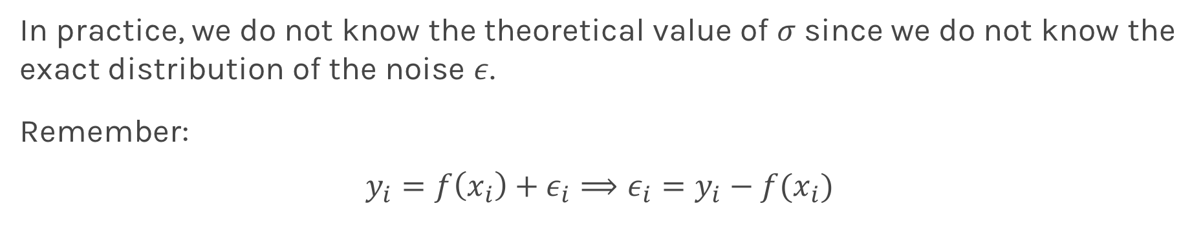
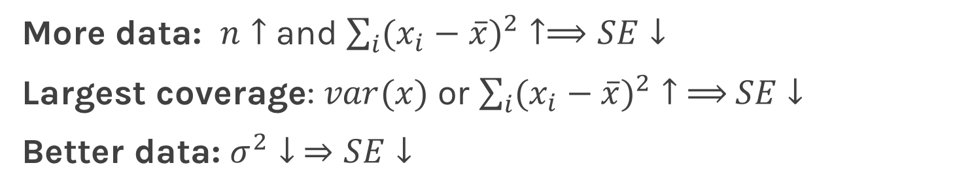
Standard Errors
More data: $n↑$ and $\sum_{i}{({x_{i}−\overline{x})}^{2}}↑⟹SE↓$
Largest coverage: $var(x)$ or $\sum_{i}{({x_{i}−\overline{x})}^{2}}↑ ⟹$ $SE↓$
Better data: $σ^{2}↓ ⇒SE↓$
In practice, we do not know the theoretical value of $σ$ since we do not know the exact distribution of the noise $ε$.
Remember:
$$y_{i}=f\left(x_{i}\right)+ε_{i}⟹ε_{i}=y_{i}−f(x_{i})$$
Notes:
If data set is small this approximation does not work

Slide 5
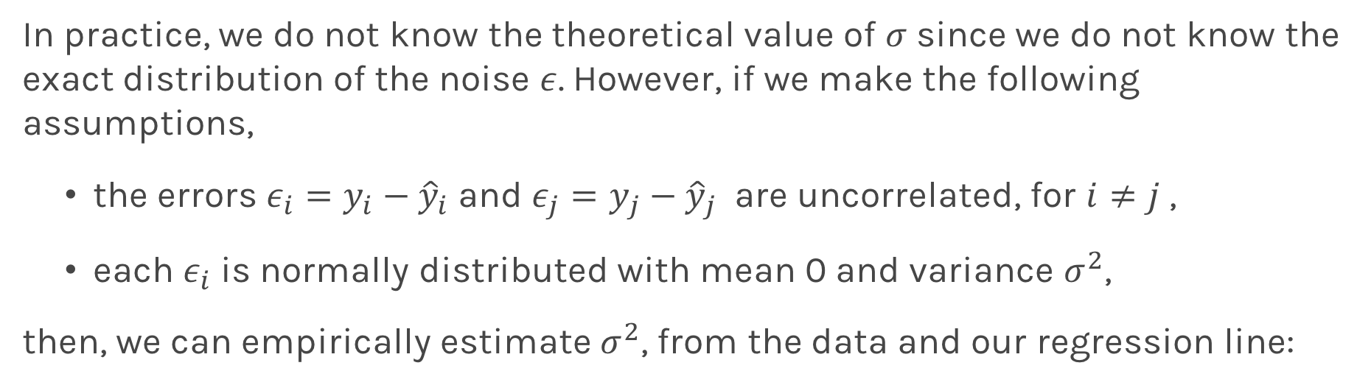
Standard Errors
In practice, we do not know the theoretical value of $σ$ since we do not know the exact distribution of the noise $ε$. However, if we make the following assumptions,
the errors $ε_{i}=y_{i}−{\hat{y}}_{i}$and $ε_{j}=y_{j}−{\hat{y}}_{j}$ are uncorrelated, for $i≠j$ ,
each $ε_{i}$ is normally distributed with mean 0 and variance $σ^{2}$,
then, we can empirically estimate $σ^{2}$, from the data and our regression line:

Slide 6

Standard Errors
More data: $n↑$ and $\sum_{i}{({x_{i}−\overline{x})}^{2}}↑⟹SE↓$
Largest coverage: $var(x)$ or $\sum_{i}{({x_{i}−\overline{x})}^{2}}↑ ⟹$ $SE↓$
Better data: $σ^{2}↓ ⇒SE↓$
Better model: $(\hat{f}−y_{i}) ↓$ $⟹σ↓ ⟹SE↓$
Question: What happens to the $\hat{β_{0}}$, $\hat{β_{1}}$ under these scenarios?
Notes:
Not change, because SE doesn’t affect the two model estimators

Slide 7
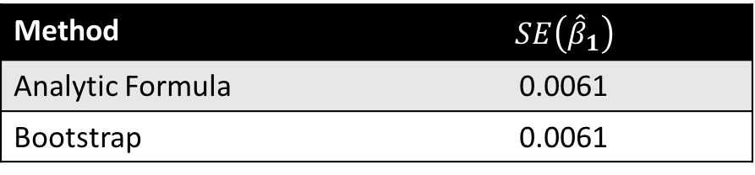

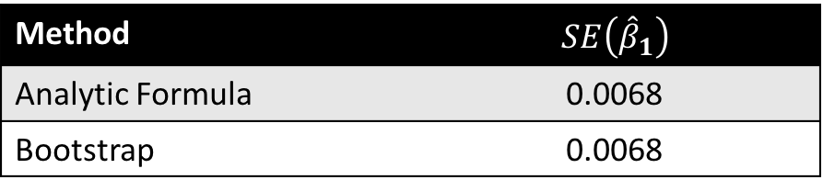
Standard Errors
The following results are for the coefficients for TV advertising:
Method | $$SE\left({\hat{β}}_{1}\right)$$
Analytic Formula | 0.0061
Bootstrap | 0.0061
The coefficients for TV advertising but restricting the coverage of x are:
The coefficients for TV advertising but with added extra noise:
Method | $$SE\left({\hat{β}}_{1}\right)$$
Analytic Formula | 0.0068
Bootstrap | 0.0068
This makes no sense?
Method | $$SE\left({\hat{β}}_{1}\right)$$
Analytic Formula | 0.0028
Bootstrap | 0.0023
Notes:
Because the estimator gets smaller (with added noise) in this case

Slide 8
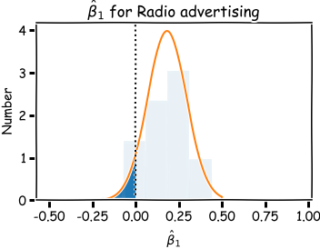
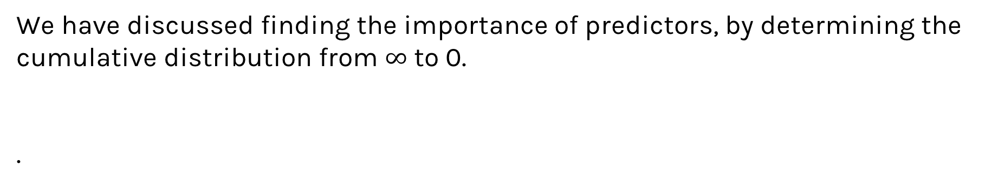
Importance of predictors
We have discussed finding the importance of predictors, by determining the cumulative distribution from $∞$ to 0.
.
Notes:
How to know if the high frequency of 0.25 observed here is not just noise?: Randomly shuffle x or y (the col in data frame)

Slide 9
Hypothesis Testing
Hypothesis testing is a formal process through which we evaluate the validity of a statistical hypothesis by considering evidence for or against the hypothesis gathered by random sampling of the data.

Slide 10
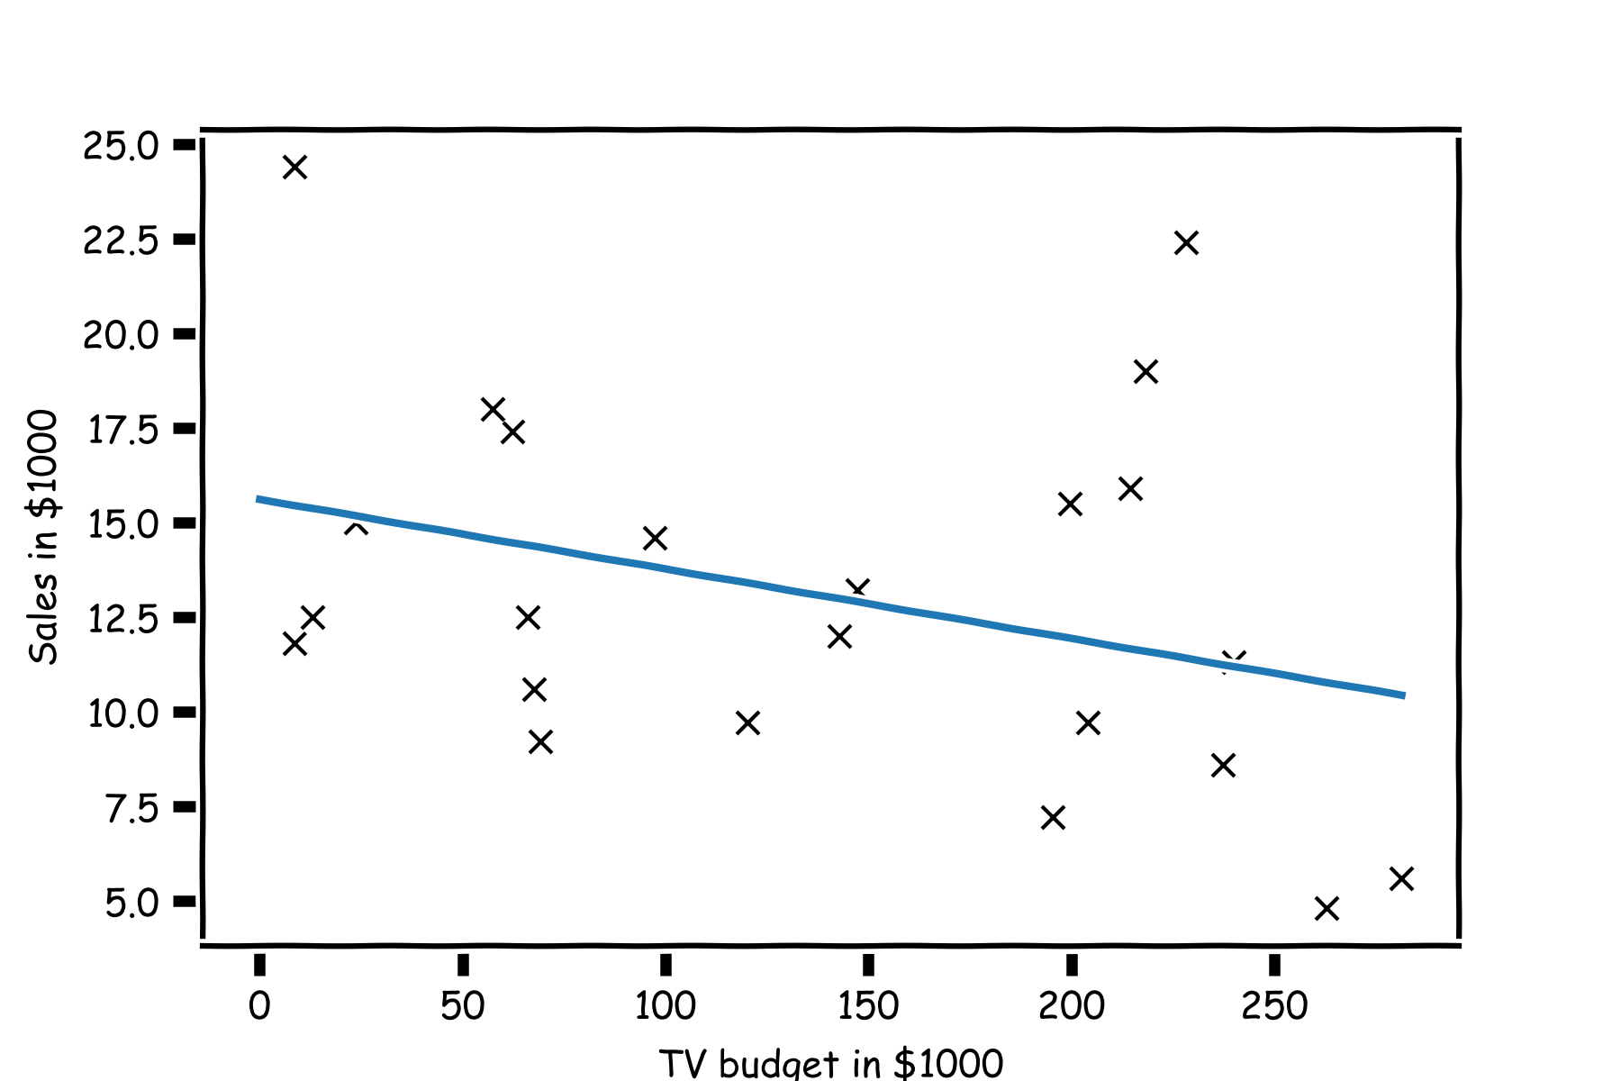
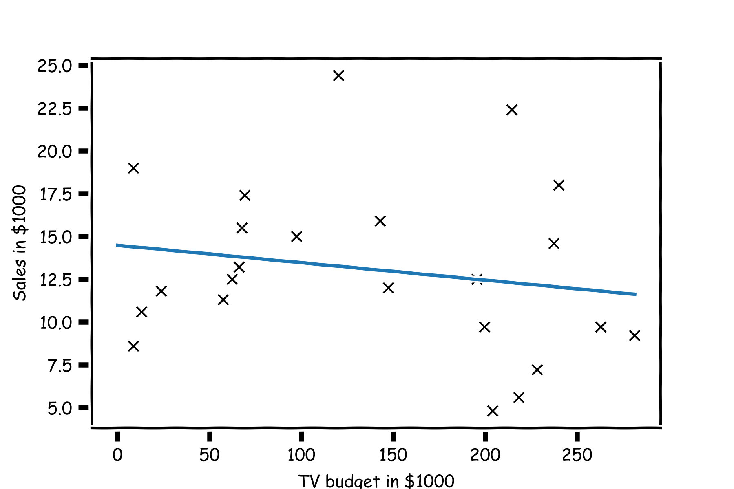
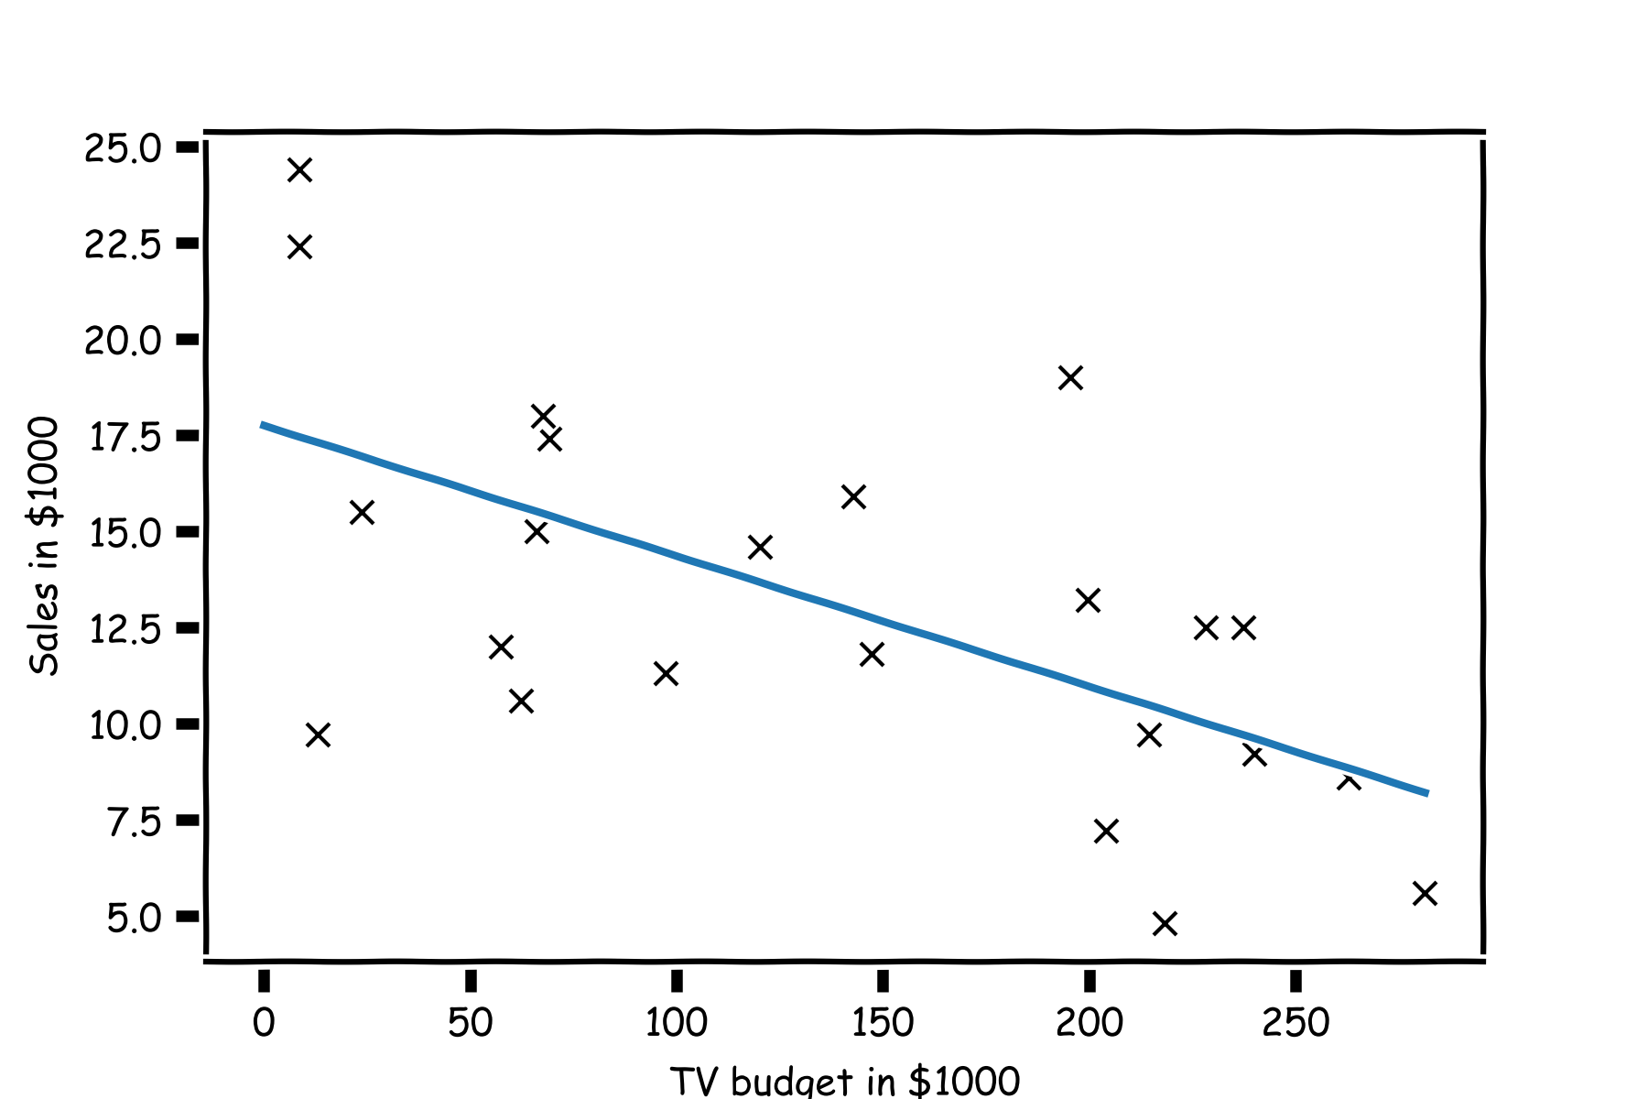
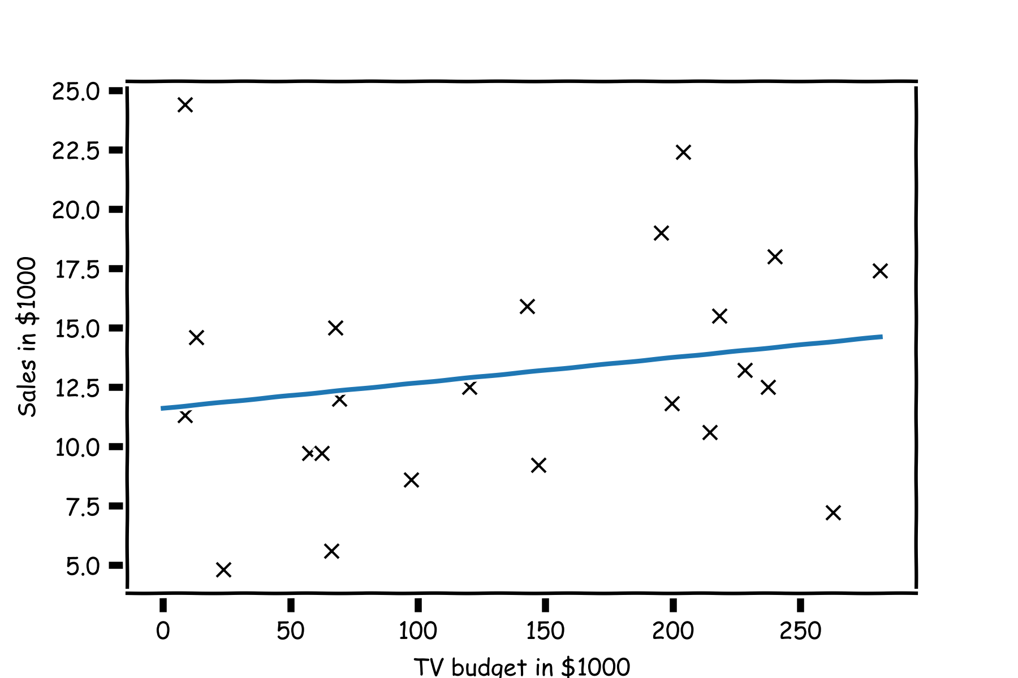
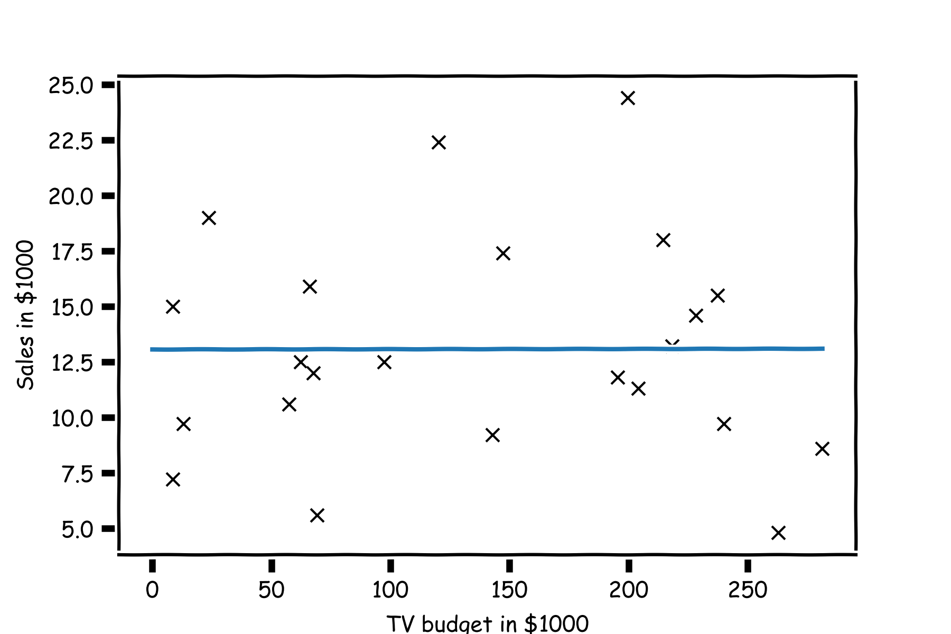
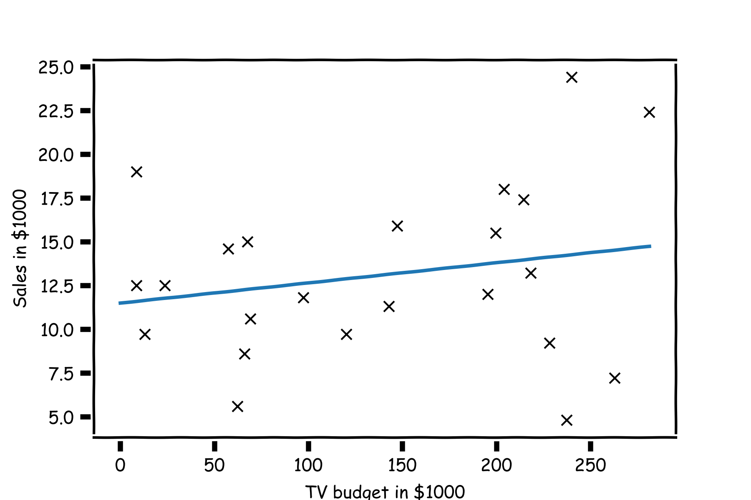
TV | sales
68.4 | 22.1
202.5 | 10.4
248.8 | 9.3
191.1 | 18.5
23.8 | 12.9
296.4 | 7.2
26.8 | 11.8
164.5 | 13.2
209.6 | 4.8
147.3 | 10.6
139.2 | 8.6
109.8 | 17.4
43.0 | 9.2
73.4 | 9.7
262.7 | 19.0
28.6 | 22.4
135.2 | 12.5
240.1 | 24.4
Random sampling of the data
Shuffle the values of the predictor variable
TV | sales
50.0 | 22.1
184.9 | 10.4
11.7 | 9.3
219.8 | 18.5
13.1 | 12.9
248.8 | 7.2
76.4 | 11.8
197.6 | 13.2
195.4 | 4.8
75.5 | 10.6
238.2 | 8.6
222.4 | 17.4
171.3 | 9.2
184.9 | 9.7
193.2 | 19.0
131.7 | 22.4
116.0 | 12.5
166.8 | 24.4
TV | sales
88.3 | 22.1
102.7 | 10.4
204.1 | 9.3
39.5 | 18.5
68.4 | 12.9
59.6 | 7.2
70.6 | 11.8
265.2 | 13.2
292.9 | 4.8
76.4 | 10.6
80.2 | 8.6
182.6 | 17.4
112.9 | 9.2
199.1 | 9.7
147.3 | 19.0
89.7 | 22.4
225.8 | 12.5
193.2 | 24.4
TV | sales
215.4 | 22.1
89.7 | 10.4
68.4 | 9.3
75.3 | 18.5
142.9 | 12.9
220.3 | 7.2
255.4 | 11.8
139.5 | 13.2
237.4 | 4.8
16.9 | 10.6
13.1 | 8.6
218.5 | 17.4
147.3 | 9.2
25.6 | 9.7
216.4 | 19.0
238.2 | 22.4
213.4 | 12.5
109.8 | 24.4
TV | sales
216.4 | 22.1
276.7 | 10.4
23.8 | 9.3
13.2 | 18.5
26.8 | 12.9
170.2 | 7.2
0.7 | 11.8
87.2 | 13.2
120.5 | 4.8
293.6 | 10.6
78.2 | 8.6
43.0 | 17.4
139.2 | 9.2
276.9 | 9.7
239.3 | 19.0
191.1 | 22.4
25.1 | 12.5
25.6 | 24.4
TV | sales
230.1 | 22.1
44.5 | 10.4
17.2 | 9.3
151.5 | 18.5
180.8 | 12.9
8.7 | 7.2
57.5 | 11.8
120.2 | 13.2
8.6 | 4.8
199.8 | 10.6
66.1 | 8.6
214.7 | 17.4
23.8 | 9.2
97.5 | 9.7
204.1 | 19.0
195.4 | 22.4
67.8 | 12.5
281.4 | 24.4

Slide 11
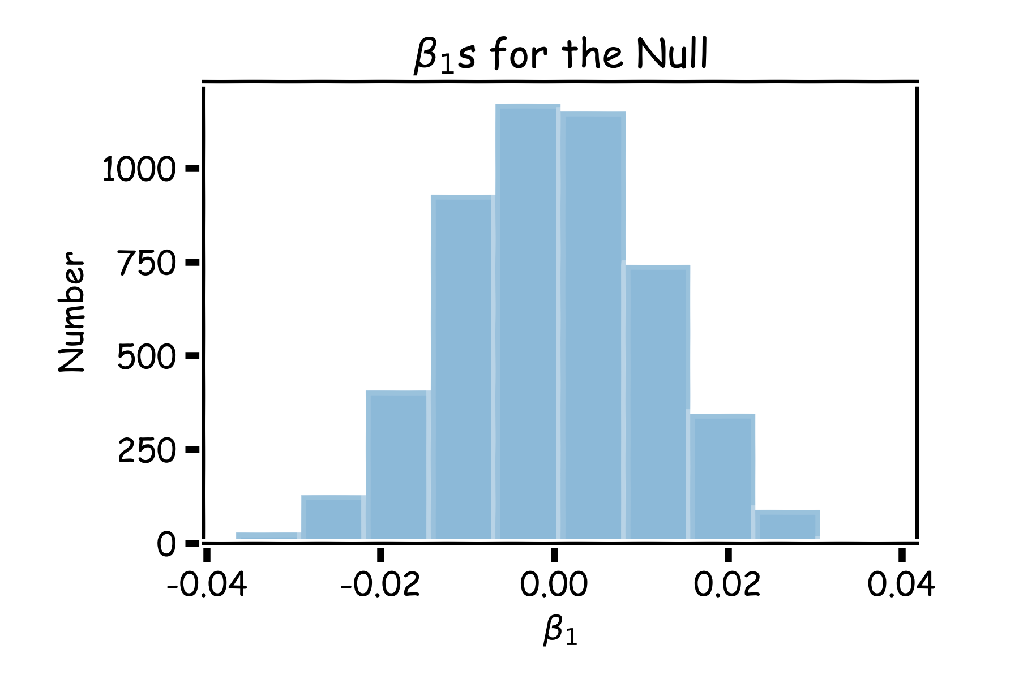
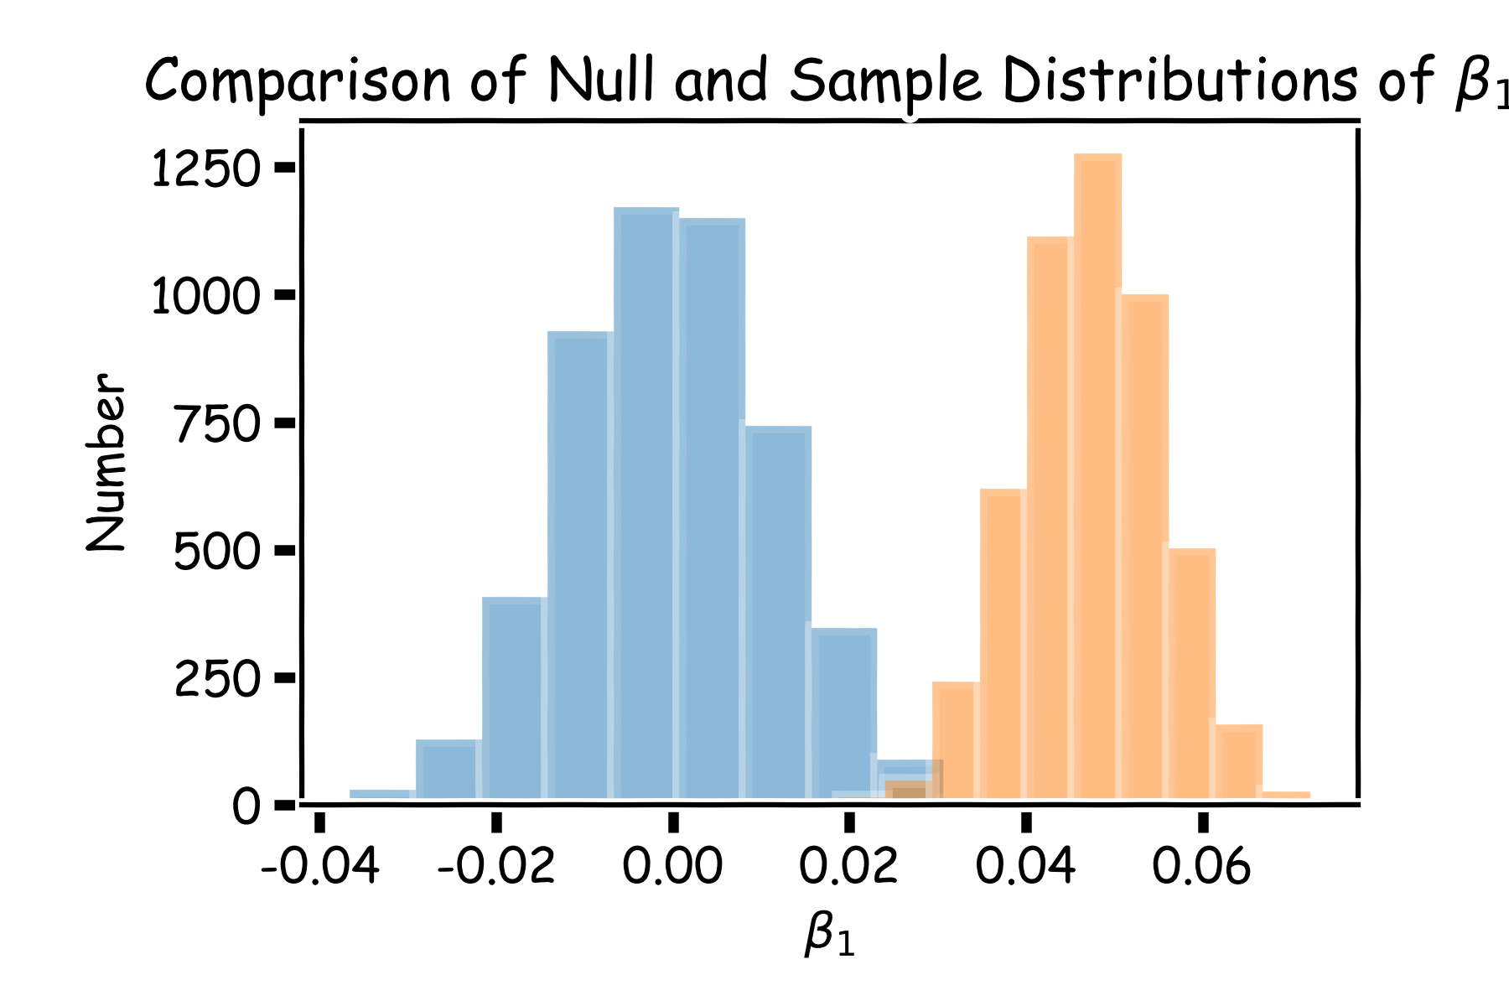
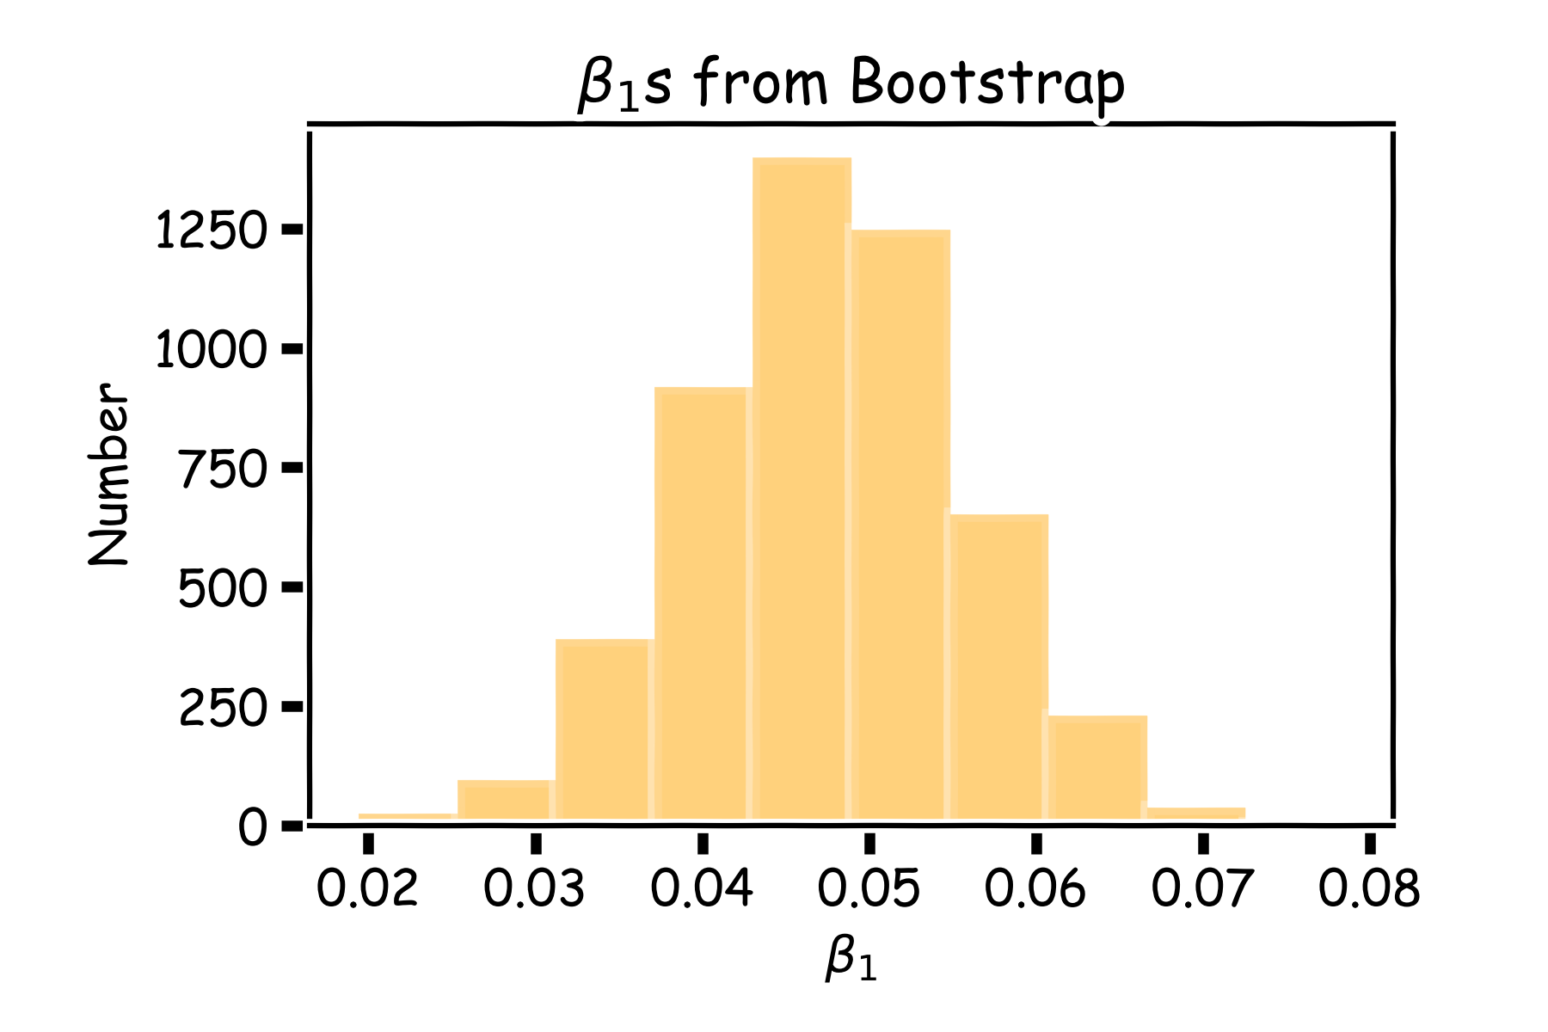
Notes:
Blue: shuffled x (NULL)

Slide 12
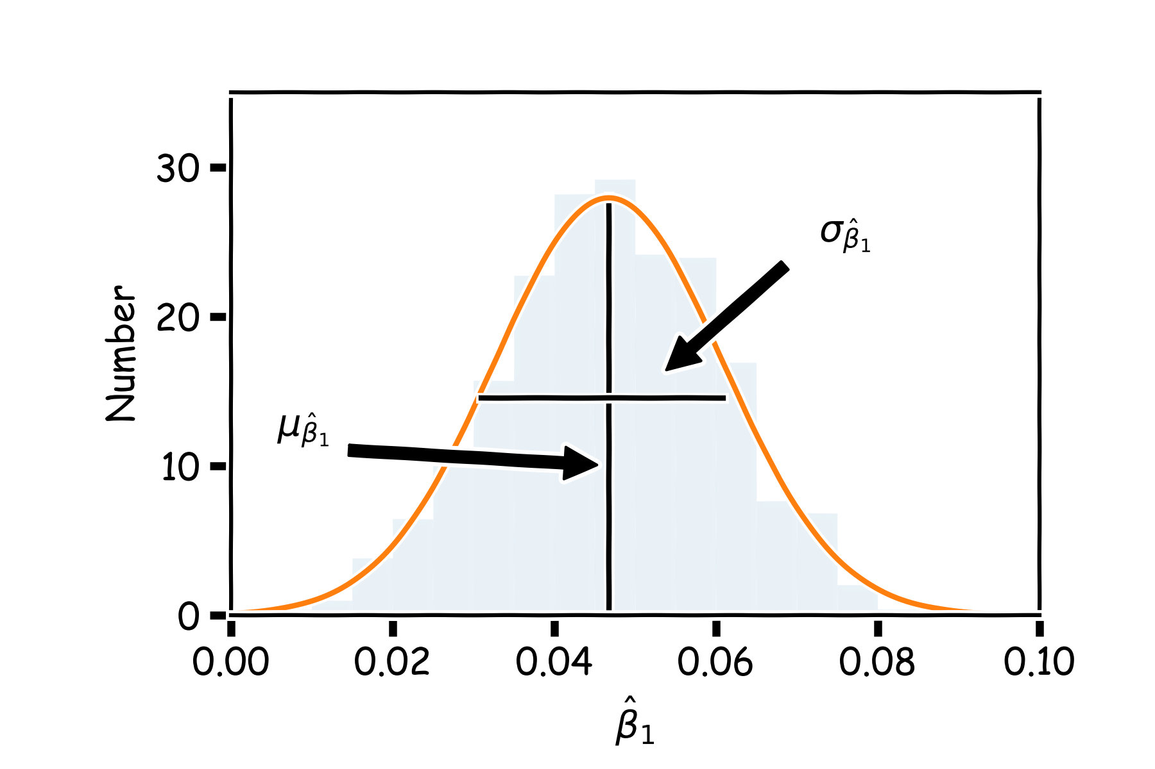
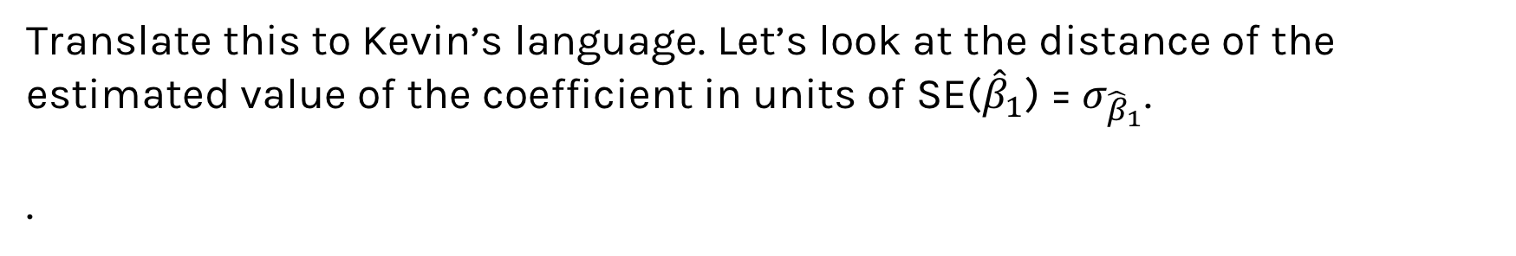
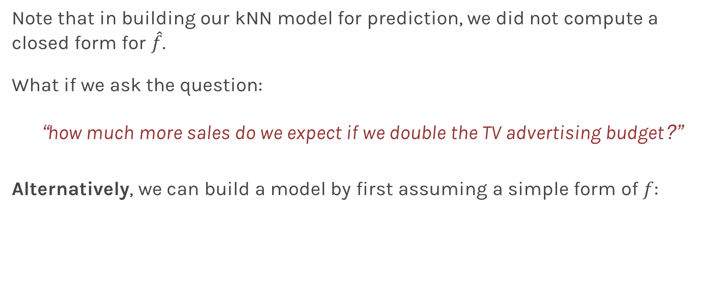
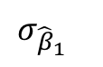
Importance of predictors
Translate this to Kevin’s language. Let’s look at the distance of the estimated value of the coefficient in units of SE(${\hat{β}}_{1}$) = $σ_{{\hat{β}}_{1}}$.
.
$$μ_{{\hat{β}}_{1}}−0$$
$$σ_{{\hat{β}}_{1}}$$
Notes:
0: as the B1 value at null

Slide 13
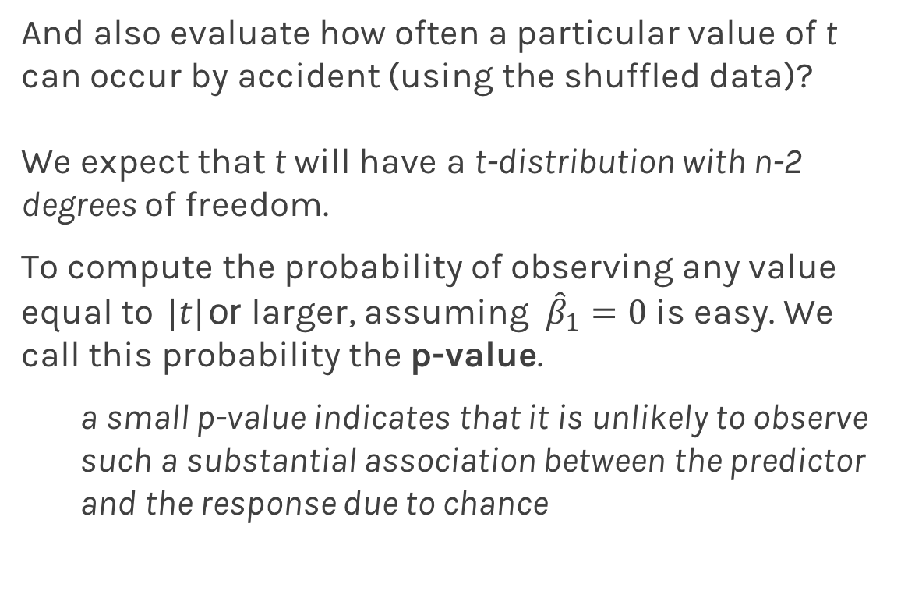
Importance of predictors
And also evaluate how often a particular value of t can occur by accident (using the shuffled data)?
We expect that t will have a t-distribution with n-2 degrees of freedom.
To compute the probability of observing any value equal to $|t|$ or larger, assuming ${\hat{β}}_{1}=0$ is easy. We call this probability the p-value.
a small p-value indicates that it is unlikely to observe such a substantial association between the predictor and the response due to chance
Notes:
Why is the df n-2?

Slide 14
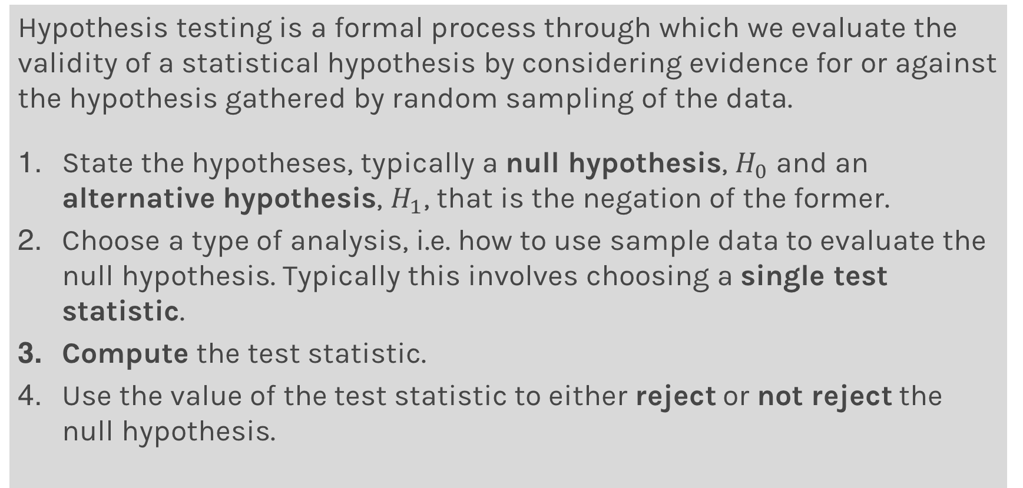
Hypothesis Testing
Hypothesis testing is a formal process through which we evaluate the validity of a statistical hypothesis by considering evidence for or against the hypothesis gathered by random sampling of the data.
State the hypotheses, typically a null hypothesis, $H_{0}$ and an alternative hypothesis, $H_{1}$, that is the negation of the former.
Choose a type of analysis, i.e. how to use sample data to evaluate the null hypothesis. Typically this involves choosing a single test statistic.
Compute the test statistic.
Use the value of the test statistic to either reject or not reject the null hypothesis.

Slide 15
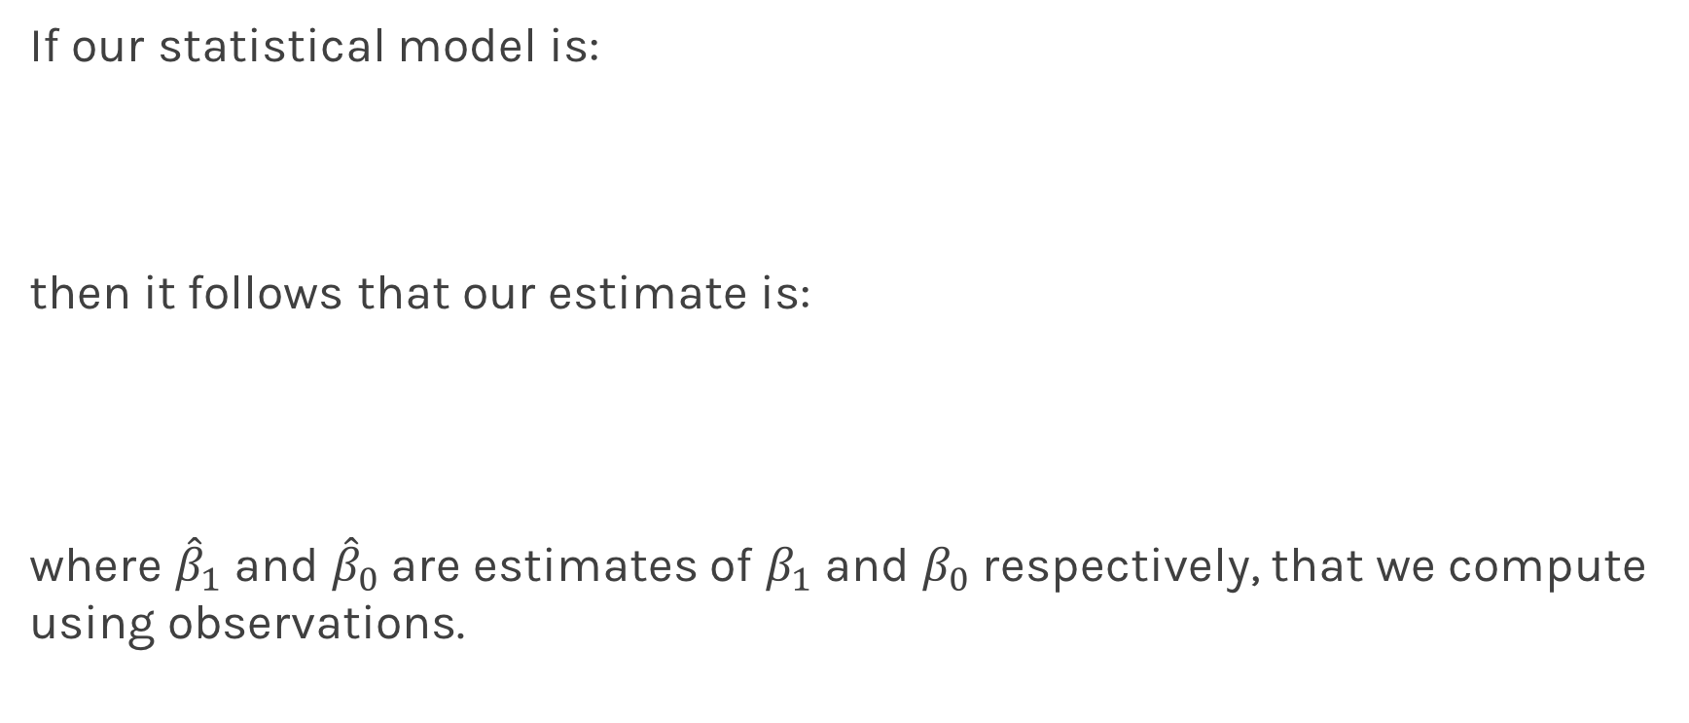
Hypothesis testing
1. State Hypothesis:
Null hypothesis:
$H_{0}$: There is no relation between X and Y
The alternative:
$H_{a}$: There is some relation between X and Y
2: Choose test statistics
To test the null hypothesis, we need to determine whether, our estimate for ${\hat{β}}_{1}$, is sufficiently far from zero that we can be confident that ${\hat{β}}_{1}$ is non-zero. We use the following test statistic:

Slide 16
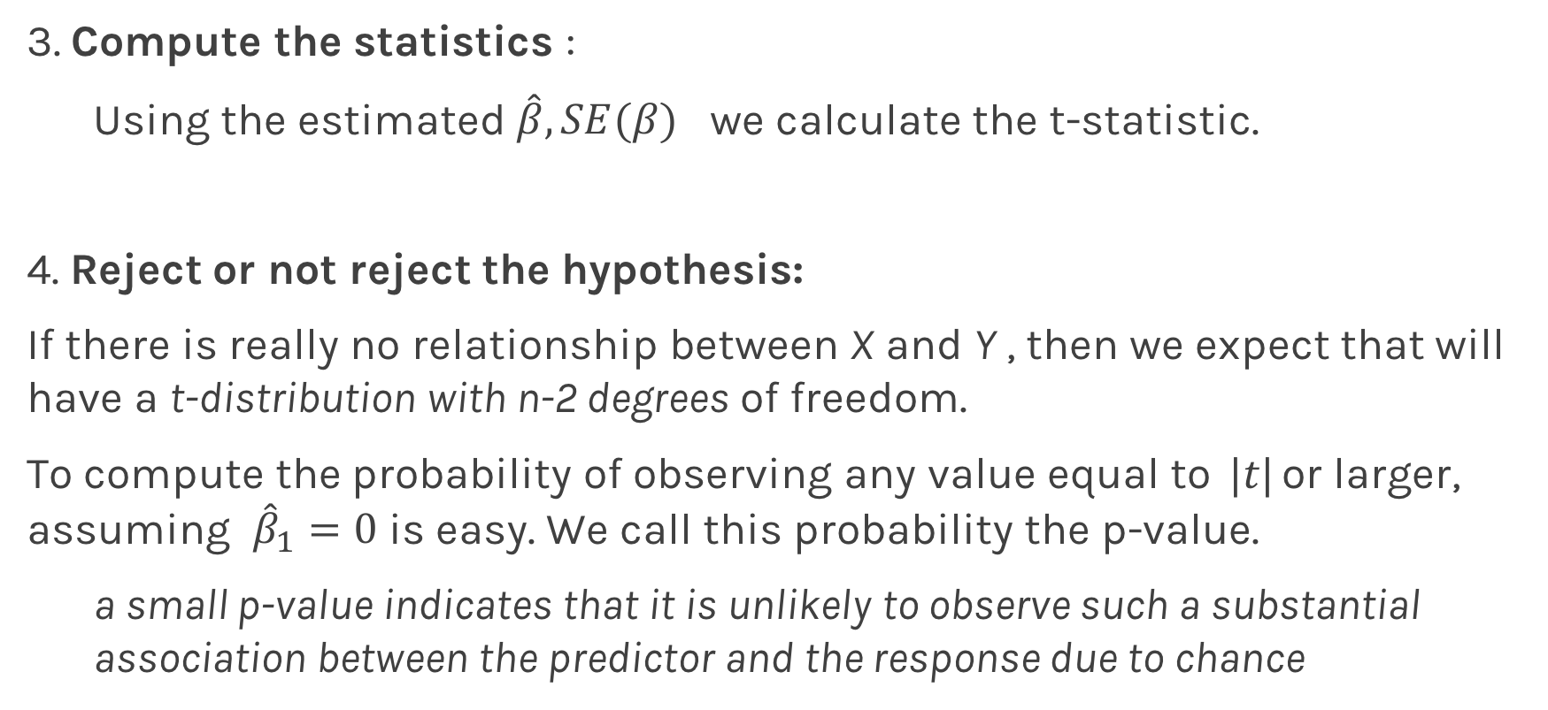
Hypothesis testing
3. Compute the statistics :
Using the estimated ${\hat{β}, SE(β)}_{}$we calculate the t-statistic.
4. Reject or not reject the hypothesis:
If there is really no relationship between X and Y , then we expect that will have a t-distribution with n-2 degrees of freedom.
To compute the probability of observing any value equal to $|t|$ or larger, assuming ${\hat{β}}_{1}=0$ is easy. We call this probability the p-value.
a small p-value indicates that it is unlikely to observe such a substantial association between the predictor and the response due to chance

Slide 17
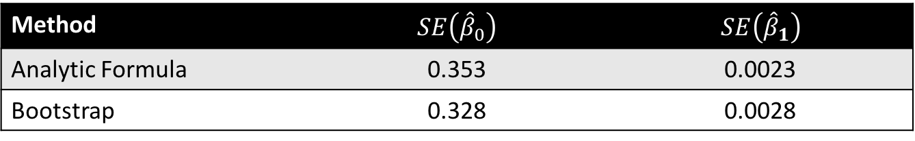
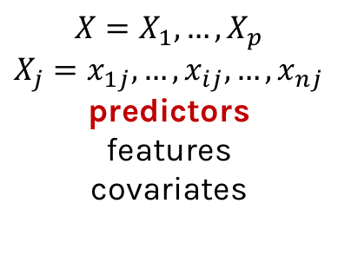

Hypothesis testing
P-values for all three predictors done independently
Method | $$SE\left({\hat{β}}_{0}\right)$$ | $$SE\left({\hat{β}}_{1}\right)$$
Analytic Formula | 0.353 | 0.0023
Bootstrap | 0.328 | 0.0028
Method | $$SE\left({\hat{β}}_{0}\right)$$ | $$SE\left({\hat{β}}_{1}\right)$$
Analytic Formula | 0.353 | 0.0023
Bootstrap | 0.328 | 0.0028
Method | $$SE\left({\hat{β}}_{0}\right)$$ | $$SE\left({\hat{β}}_{1}\right)$$
Analytic Formula | 0.353 | 0.0023
Bootstrap | 0.328 | 0.0028

Slide 18
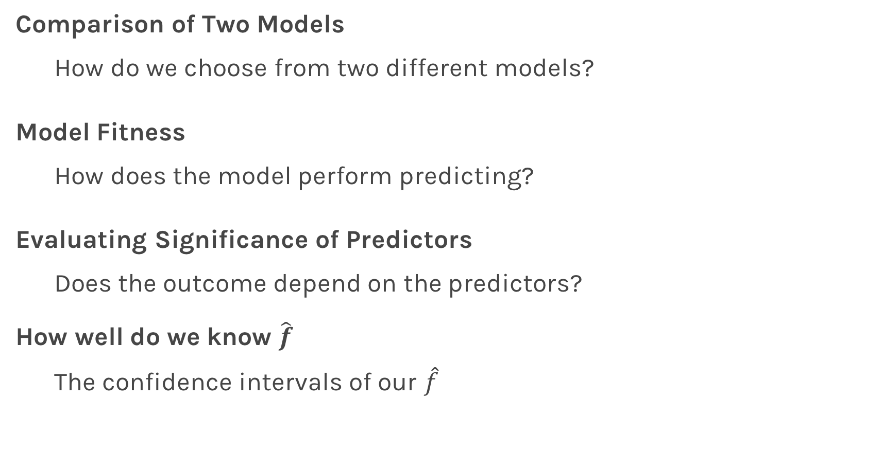
Things to Consider
Comparison of Two Models
How do we choose from two different models?
Model Fitness
How does the model perform predicting?
Evaluating Significance of Predictors
Does the outcome depend on the predictors?
How well do we know $\hat{f}$
The confidence intervals of our $\hat{f}$
Notes:
F^: estimate of the model

Slide 19
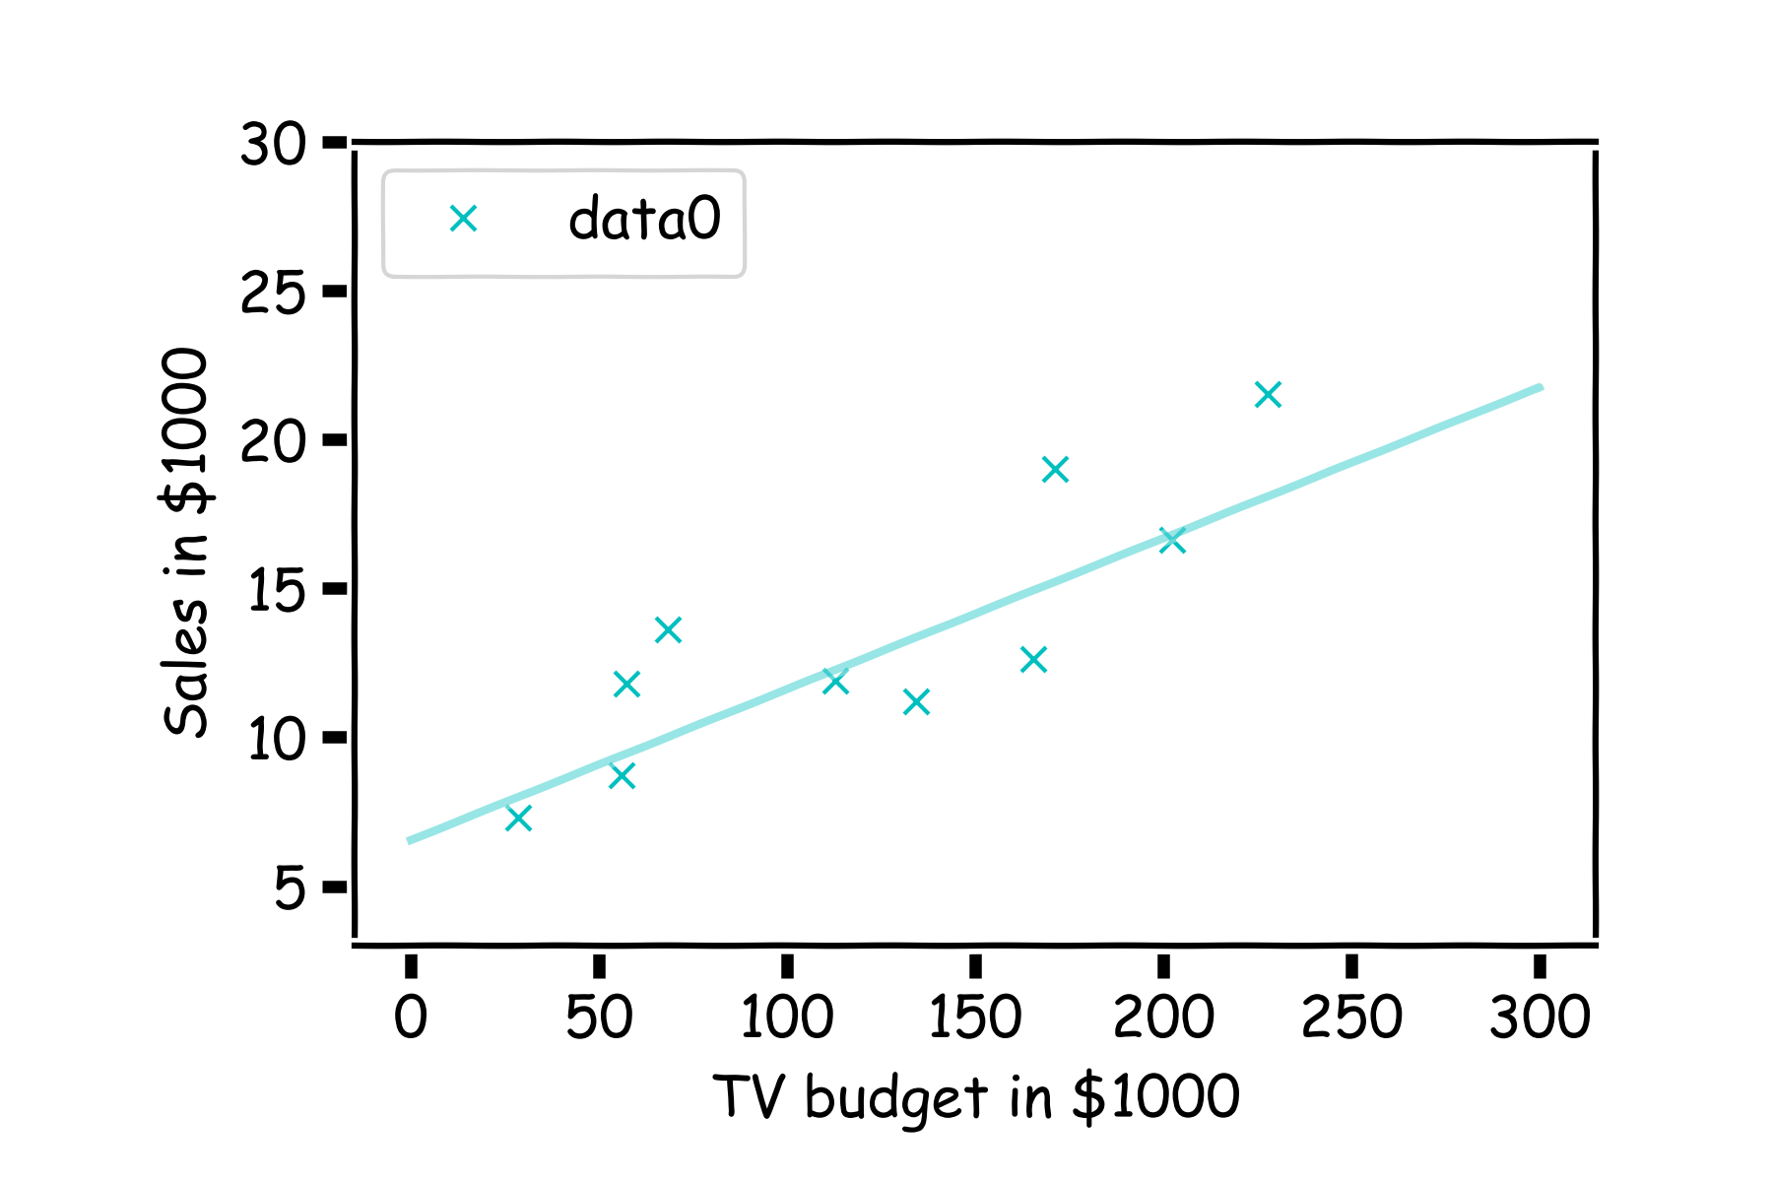
How well do we know $\hat{f}$?
Our confidence in $f$ is directly connected with the confidence in $β$s. So for each $β$ we can determine the model.

Slide 20
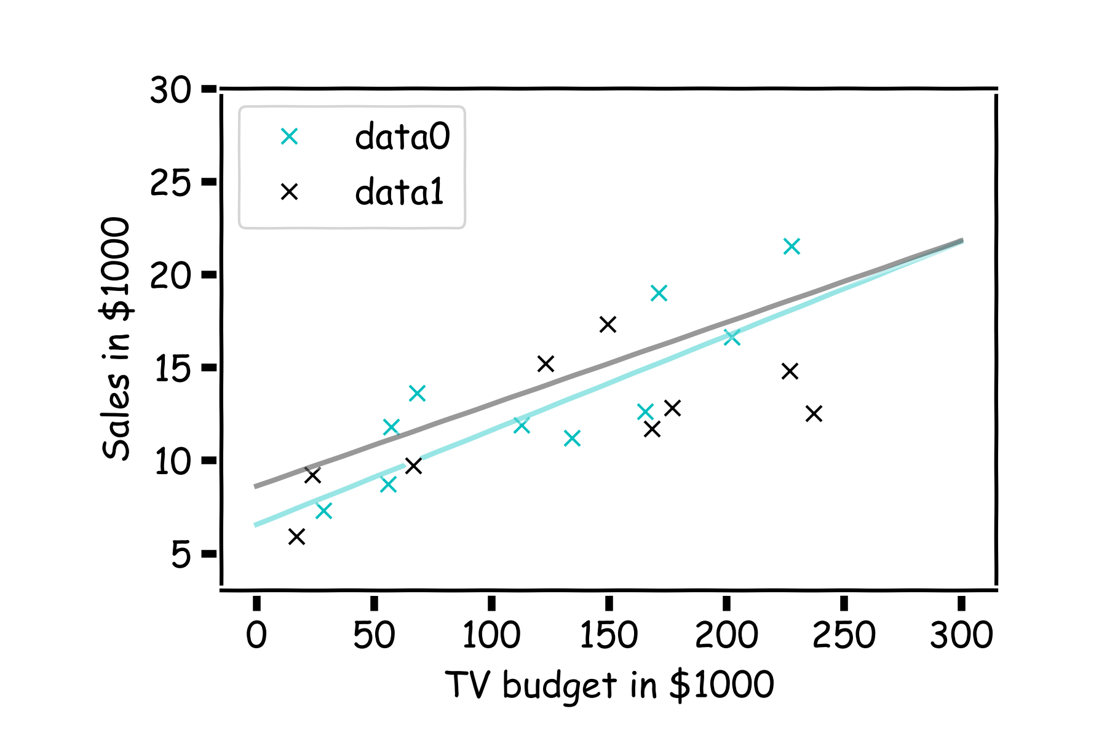
How well do we know $\hat{f}$?
Here we show two difference set of models given the fitted coefficients for a given subsample

Slide 21
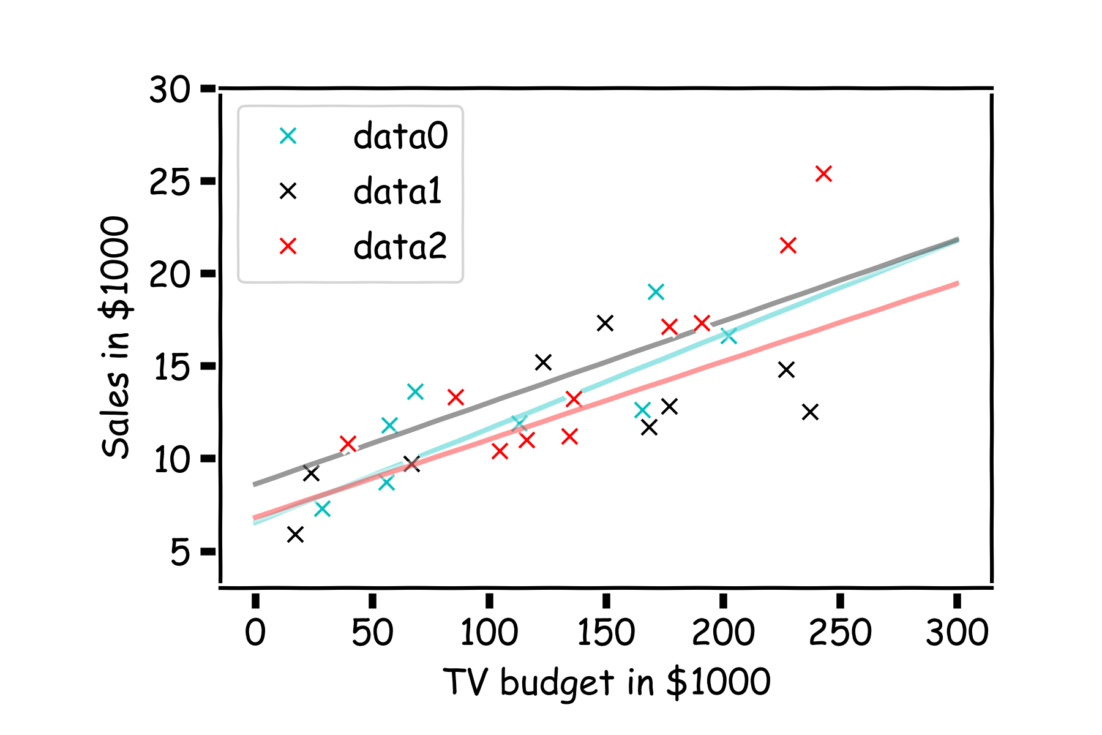
How well do we know $\hat{f}$?
There is one such regression line for every imaginable sub-sample.

Slide 22
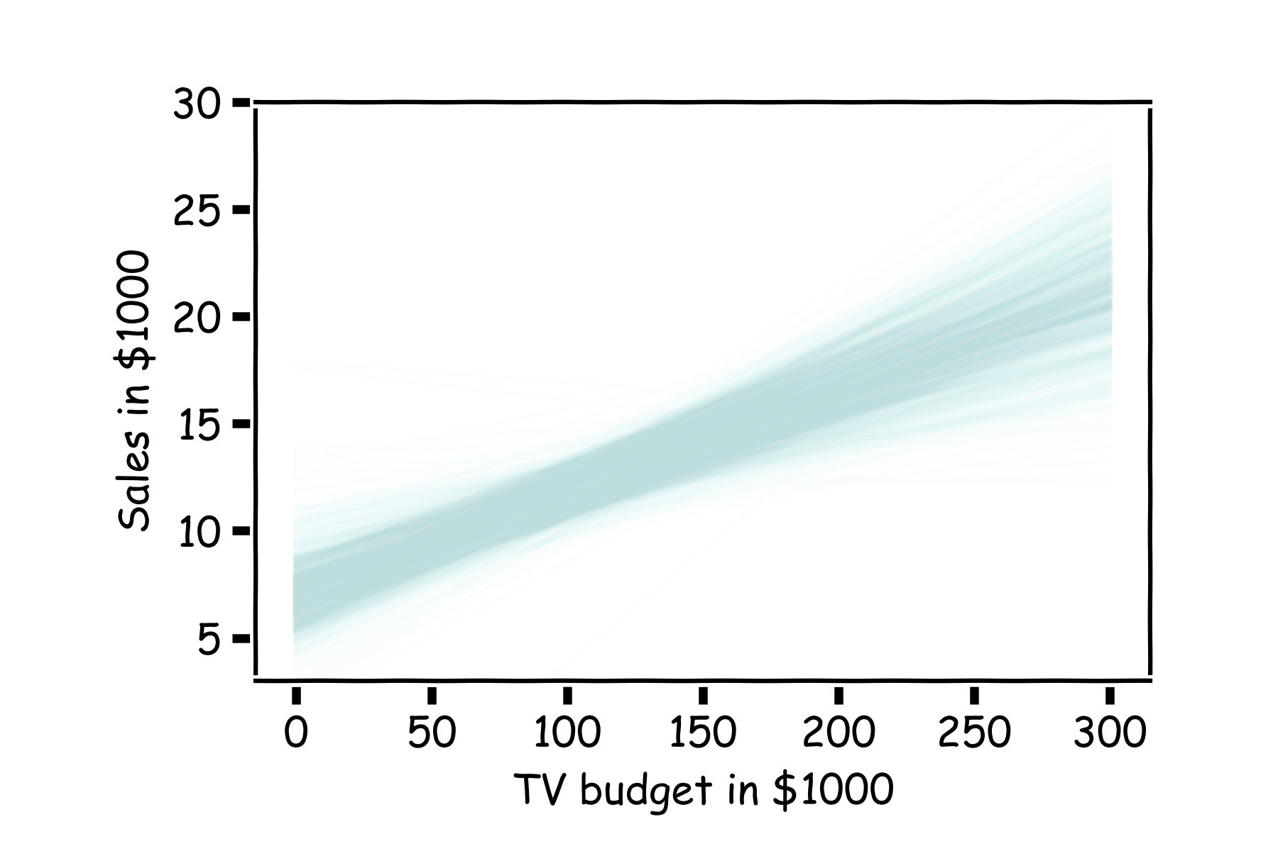
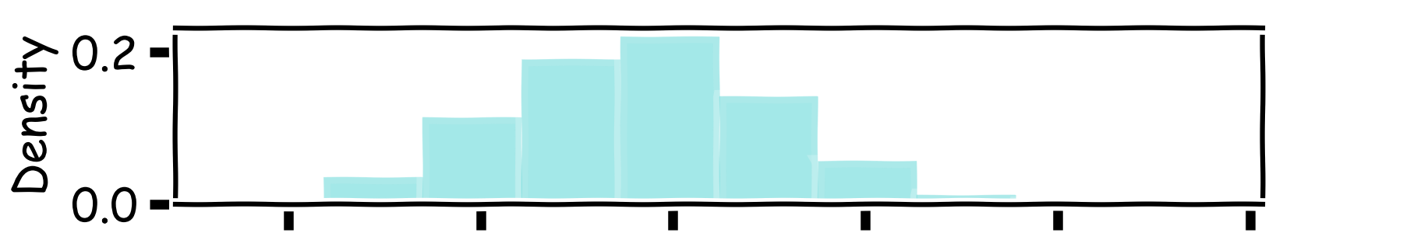
How well do we know $\hat{f}$?
Below we show all regression lines for a thousand of such sub-samples.
For a given $x$, we examine the distribution of $\hat{f}$, and determine the mean and standard deviation.

Slide 23
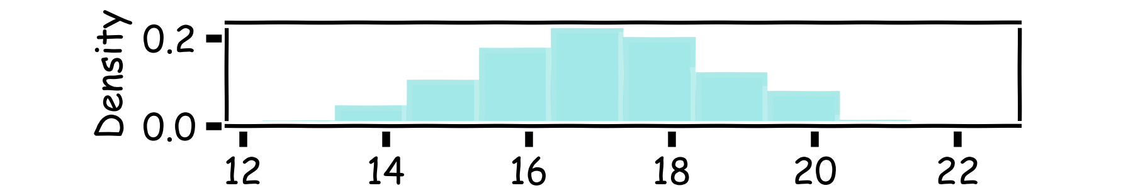
How well do we know $\hat{f}$?
Below we show all regression lines for a thousand of such sub-samples.
For a given $x$, we examine the distribution of $\hat{f}$, and determine the mean and standard deviation.

Slide 24
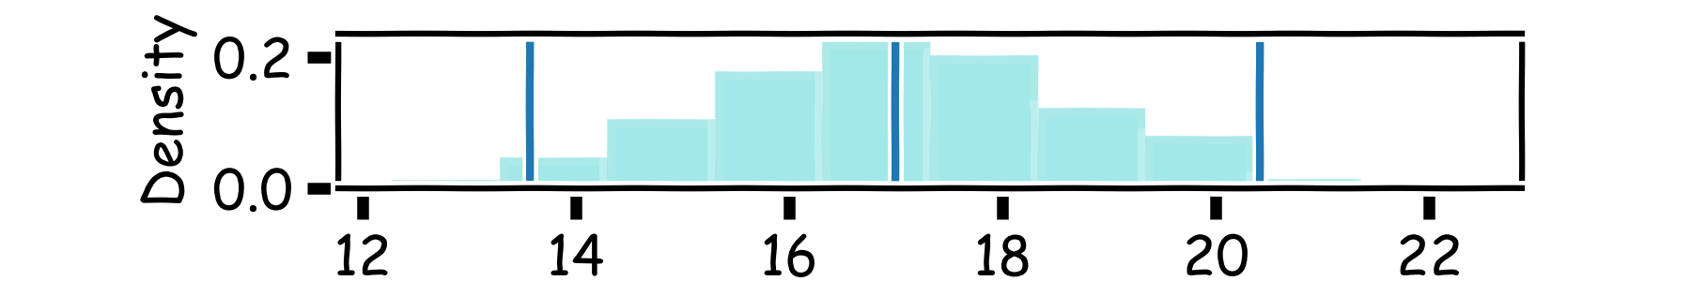
How well do we know $\hat{f}$?
Below we show all regression lines for a thousand of such sub-samples.
For a given $x$, we examine the distribution of $\hat{f}$, and determine the mean and standard deviation.

Slide 25
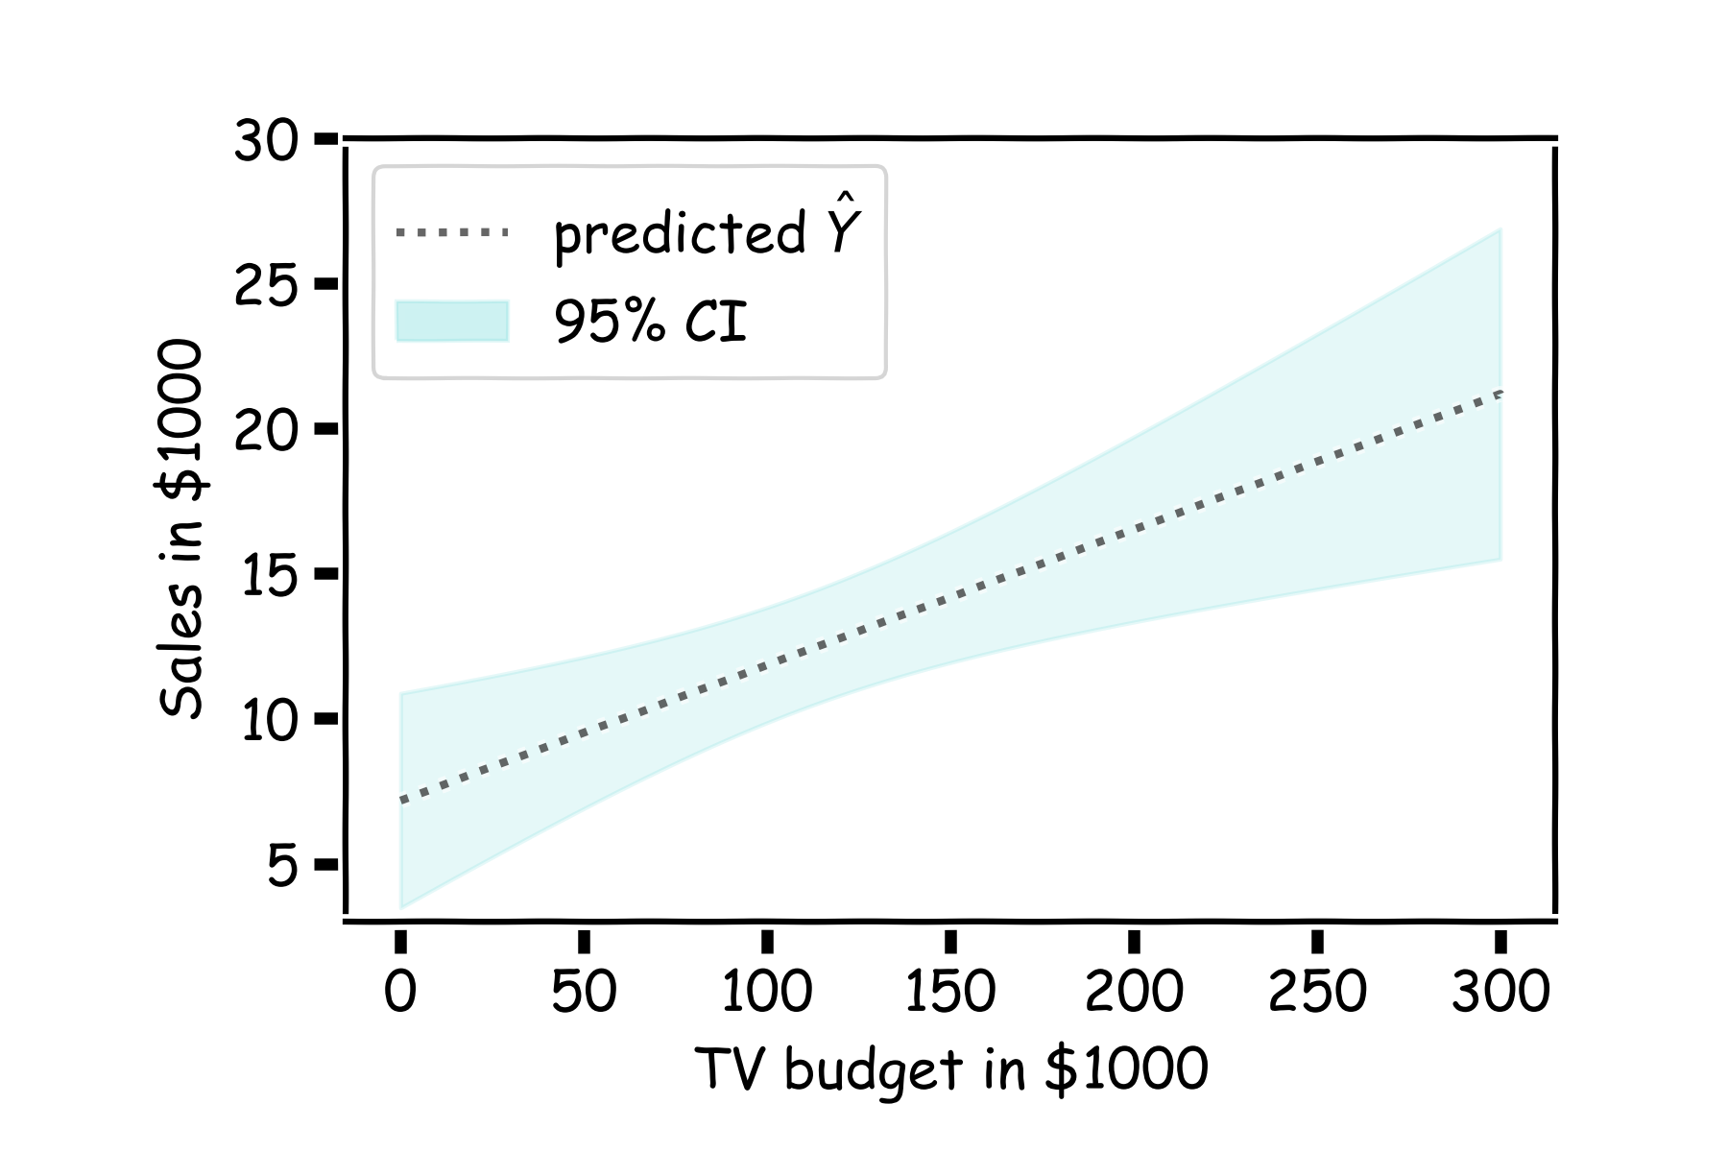
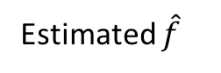
How well do we know $\hat{f}$?
For every $x$, we calculate the mean of the models, $\hat{f}$ (shown with dotted line) and the 95% CI of those models (shaded area).
Estimated $\hat{f}$
Notes:
95% of my model will go through that point

Slide 26

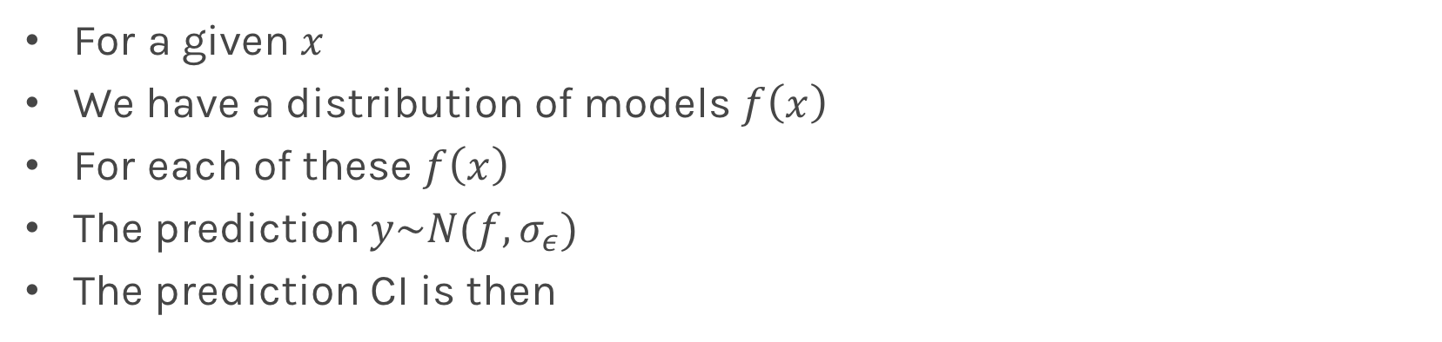
Confidence in predicting $\hat{y}$
For a given $x$
We have a distribution of models $f\left(x\right)$
For each of these $f\left(x\right)$
The prediction $y\sim N(f, σ_{ε})$
The prediction CI is then
Estimated $\hat{f}$
Notes:
Uncertainty in model coefficients -> uncertainty in model prediction value (y^)

Slide 27
Multiple Linear Regression

Slide 28
Multiple Linear Regression
If you have to guess someone's height, would you rather be told
Their weight, only
Their weight and gender
Their weight, gender, and income
Their weight, gender, income, and favorite number
Of course, you'd always want as much data about a person as possible. Even though height and favorite number may not be strongly related, at worst you could just ignore the information on favorite number. We want our models to be able to take in lots of data as they make their predictions.

Slide 29
Response vs. Predictor Variables
X
predictors
features
covariates
Y
outcome
response variable
dependent variable
TV | radio | newspaper | sales
230.1 | 37.8 | 69.2 | 22.1
44.5 | 39.3 | 45.1 | 10.4
17.2 | 45.9 | 69.3 | 9.3
151.5 | 41.3 | 58.5 | 18.5
180.8 | 10.8 | 58.4 | 12.9
n observations
p predictors

Slide 30
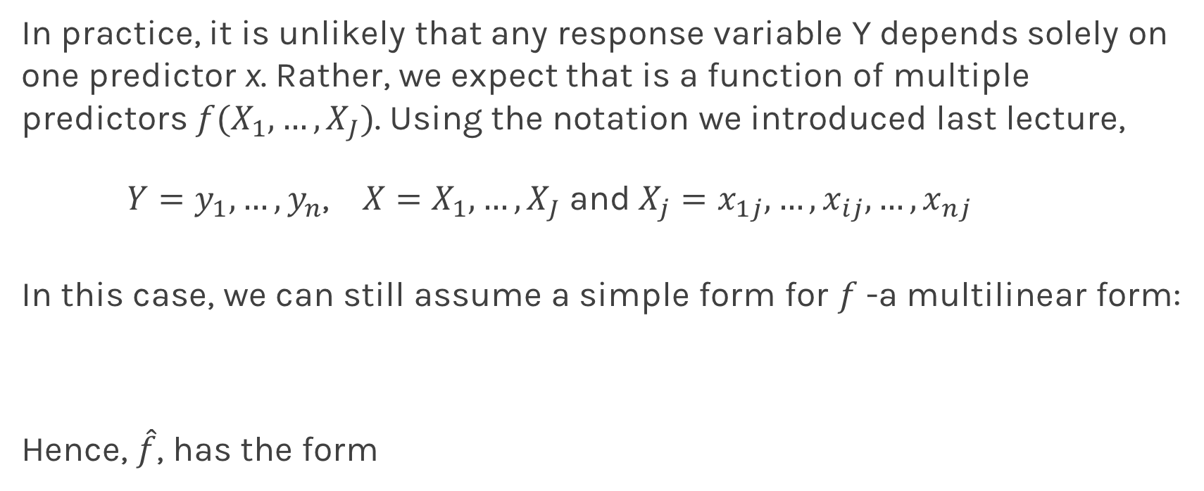
Multilinear Models
In practice, it is unlikely that any response variable Y depends solely on one predictor x. Rather, we expect that is a function of multiple predictors $f(X_{1},…,X_{J})$. Using the notation we introduced last lecture,
$Y=y_{1},…,y_{n}$, $X=X_{1},…,X_{J}$and$X_{j}=x_{1j},…,x_{ij},…,x_{nj}$
In this case, we can still assume a simple form for $f$-a multilinear form:
Hence, $\hat{f}$, has the form
Notes:
Xj: j = different predictors

Slide 31
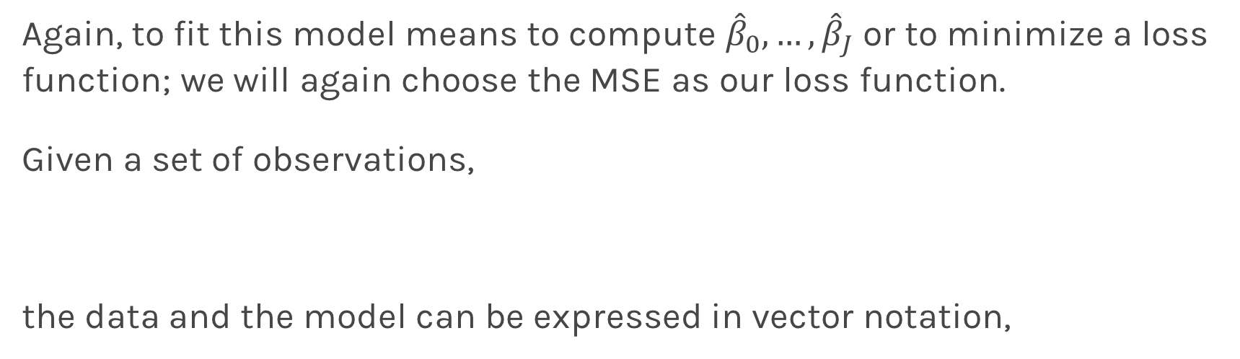
Multiple Linear Regression
Again, to fit this model means to compute ${\hat{β}}_{0},…,{\hat{β}}_{J}$ or to minimize a loss function; we will again choose the MSE as our loss function.
Given a set of observations,
the data and the model can be expressed in vector notation,
Notes:
We need a figure here

Slide 32
Multiple Linear Regression
The model takes a simple algebraic form:
Thus, the MSE can be expressed in vector notation as
Minimizing the MSE using vector calculus yields,
Notes:
.p inverse (approximate inverse for square-matrix)
Not invertible matrix: columns/rows that are the same

Slide 33
Collinearity
Collinearity refers to the case in which two or more predictors are correlated (related).
We will re-visit collinearity in the next lectures, but for now we want to examine how does collinearity affects our confidence on the coefficients and consequently on the importance of those coefficients.
First let’s look some examples:
Notes:
We need a figure here

Slide 34
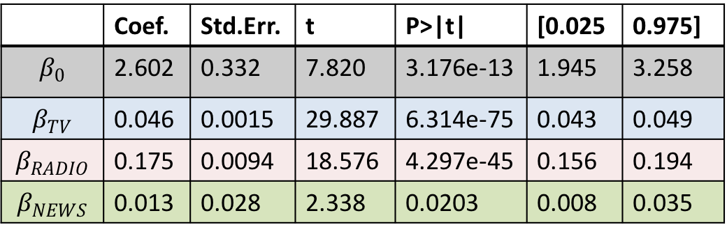
Collinearity
Three individual models
One model
TV
Coef. | Std.Err. | t | P>|t| | [0.025 | 0.975]
6.679 | 0.478 | 13.957 | 2.804e-31 | 5.735 | 7.622
0.048 | 0.0027 | 17.303 | 1.802e-41 | 0.042 | 0.053
RADIO
 | Coef. | Std.Err. | t | P>|t| | [0.025 | 0.975]
$$β_{0}$$ | 2.602 | 0.332 | 7.820 | 3.176e-13 | 1.945 | 3.258
$$β_{TV}$$ | 0.046 | 0.0015 | 29.887 | 6.314e-75 | 0.043 | 0.049
$$β_{RADIO}$$ | 0.175 | 0.0094 | 18.576 | 4.297e-45 | 0.156 | 0.194
$$β_{NEWS}$$ | 0.013 | 0.028 | 2.338 | 0.0203 | 0.008 | 0.035
Coef. | Std.Err. | t | P>|t| | [0.025 | 0.975]
9.567 | 0.553 | 17.279 | 2.133e-41 | 8.475 | 10.659
0.195 | 0.020 | 9.429 | 1.134e-17 | 0.154 | 0.236
NEWS
Coef. | Std.Err. | t | P>|t| | [0.025 | 0.975]
11.55 | 0.576 | 20.036 | 1.628e-49 | 10.414 | 12.688
0.074 | 0.014 | 5.134 | 6.734e-07 | 0.0456 | 0.102
Notes:
Coef of TV decreases after combining models

Slide 35
Collinearity
Collinearity refers to the case in which two or more predictors are correlated (related).
We will re-visit collinearity in the next lectures, but for now we want to examine how does collinearity affects our confidence on the coefficients and consequently on the importance of those coefficients.
Assuming uncorrelated noise then we can show:
Notes:
Case 1: added a predictor (noise) that’s not correlated with anything
Case 2: added a predictor that’s not correlated with anything, but with high predictive power on its own (increased sigma^2)
SE(B vector) = sigma^2(X_T X ) ^(-1)

Slide 36
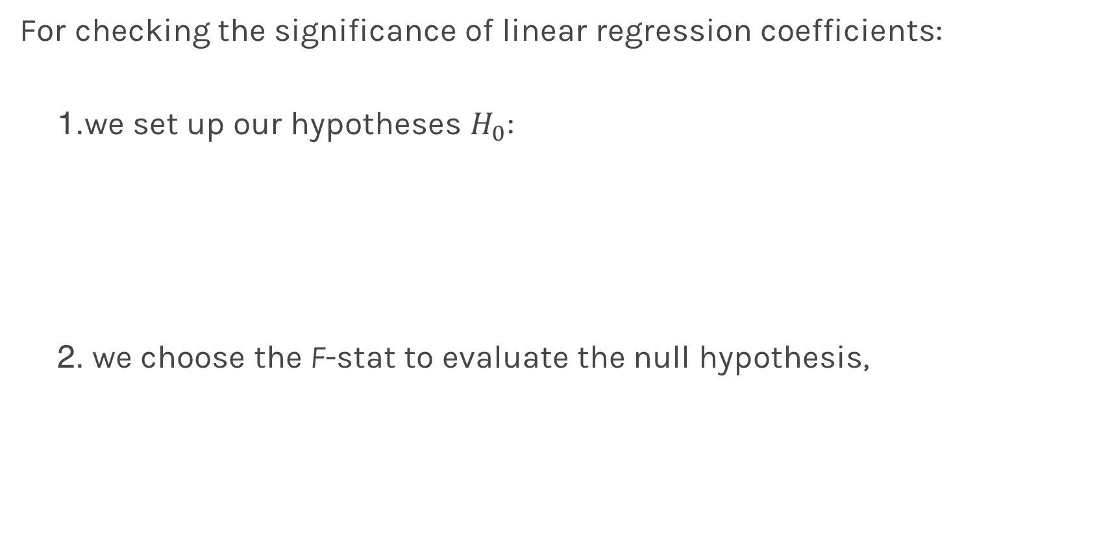
Finding Significant Predictors: Hypothesis Testing
For checking the significance of linear regression coefficients:
we set up our hypotheses $H_{0}$:
we choose the F-stat to evaluate the null hypothesis,

Slide 37
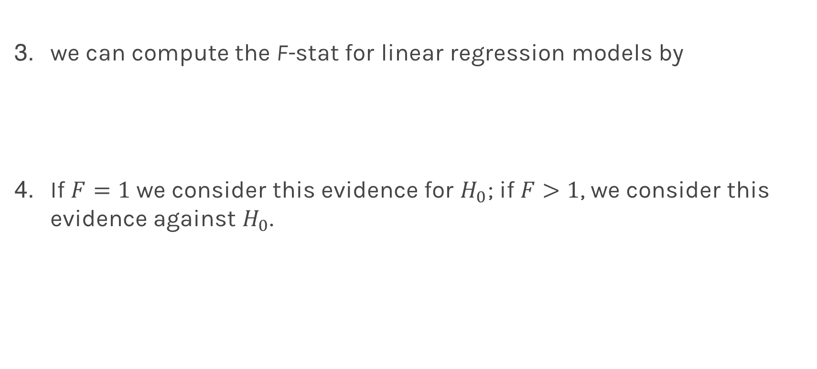
Finding Significant Predictors: Hypothesis Testing
we can compute the F-stat for linear regression models by
If $F=1$ we consider this evidence for $H_{0}$; if $F>1$, we consider this evidence against $H_{0}$.
Notes:
TSS: baseline model that computes difference to mean

Slide 38
Qualitative Predictors
So far, we have assumed that all variables are quantitative. But in practice, often some predictors are qualitative.
Example: The Credit data set contains information about balance, age, cards, education, income, limit , and rating for a number of potential customers.
Income | Limit | Rating | Cards | Age | Education | Gender | Student | Married | Ethnicity | Balance
14.890 | 3606 | 283 | 2 | 34 | 11 | Male | No | Yes | Caucasian | 333
106.02 | 6645 | 483 | 3 | 82 | 15 | Female | Yes | Yes | Asian | 903
104.59 | 7075 | 514 | 4 | 71 | 11 | Male | No | No | Asian | 580
148.92 | 9504 | 681 | 3 | 36 | 11 | Female | No | No | Asian | 964
55.882 | 4897 | 357 | 2 | 68 | 16 | Male | No | Yes | Caucasian | 331

Slide 39
Qualitative Predictors
If the predictor takes only two values, then we create an indicator or dummy variable that takes on two possible numerical values.
For example for the gender, we create a new variable:
We then use this variable as a predictor in the regression equation.

Slide 40

Qualitative Predictors
Question: What is interpretation of $β_{0}$ and $β_{1}$?

Slide 41
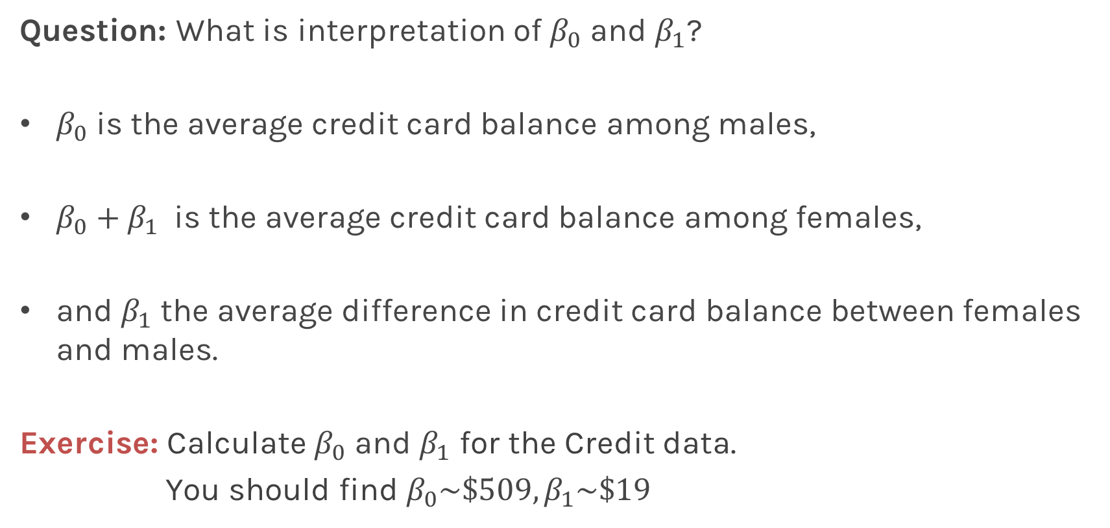
Qualitative Predictors
Question: What is interpretation of $β_{0}$ and $β_{1}$?
$β_{0}$ is the average credit card balance among males,
$β_{0}+β_{1}$ is the average credit card balance among females,
and $β_{1}$ the average difference in credit card balance between females and males.
Exercise: Calculate $β_{0}$ and $β_{1}$ for the Credit data.
You should find $β_{0}\sim \$509,β_{1}\sim \$19$

Slide 42
More than two levels: One hot encoding
Often, the qualitative predictor takes more than two values (e.g. ethnicity in the credit data).
In this situation, a single dummy variable cannot represent all possible values.
We create additional dummy variable as:

Slide 43
More than two levels: One hot encoding
We then use these variables as predictors, the regression equation becomes:
Again the interpretation
Notes:
[ADD interpretation and ONE HOT ENCODING]

Slide 44
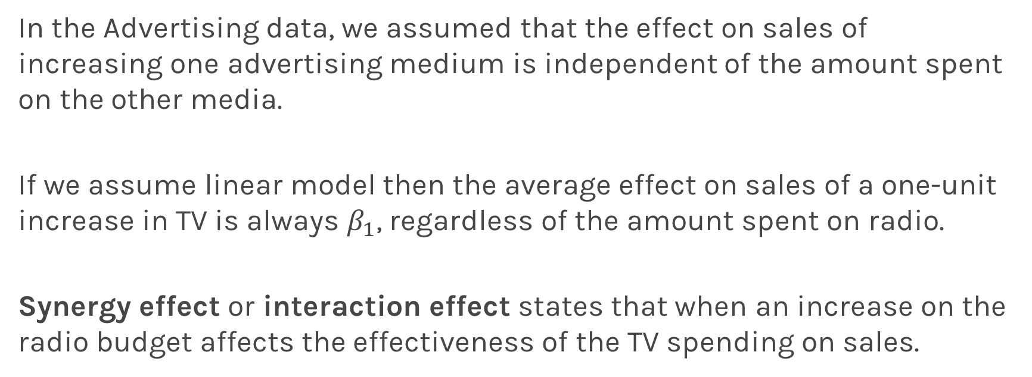
Beyond linearity
In the Advertising data, we assumed that the effect on sales of increasing one advertising medium is independent of the amount spent on the other media.
If we assume linear model then the average effect on sales of a one-unit increase in TV is always $β_{1}$, regardless of the amount spent on radio.
Synergy effect or interaction effect states that when an increase on the radio budget affects the effectiveness of the TV spending on sales.

Slide 45
Beyond linearity
We change
To

Slide 46
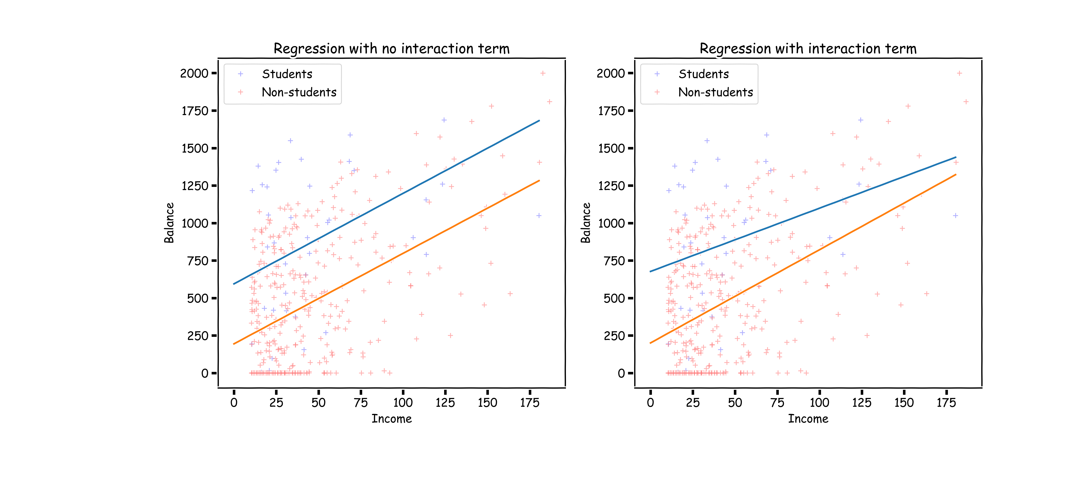
What does it mean?

Slide 47
Predictors predictors predictors
We have a lot predictors!
Is it a problem?
Yes: Computational Cost
Yes: Overfitting
Wait there is more …

Slide 48
Polynomial Regression

Slide 49
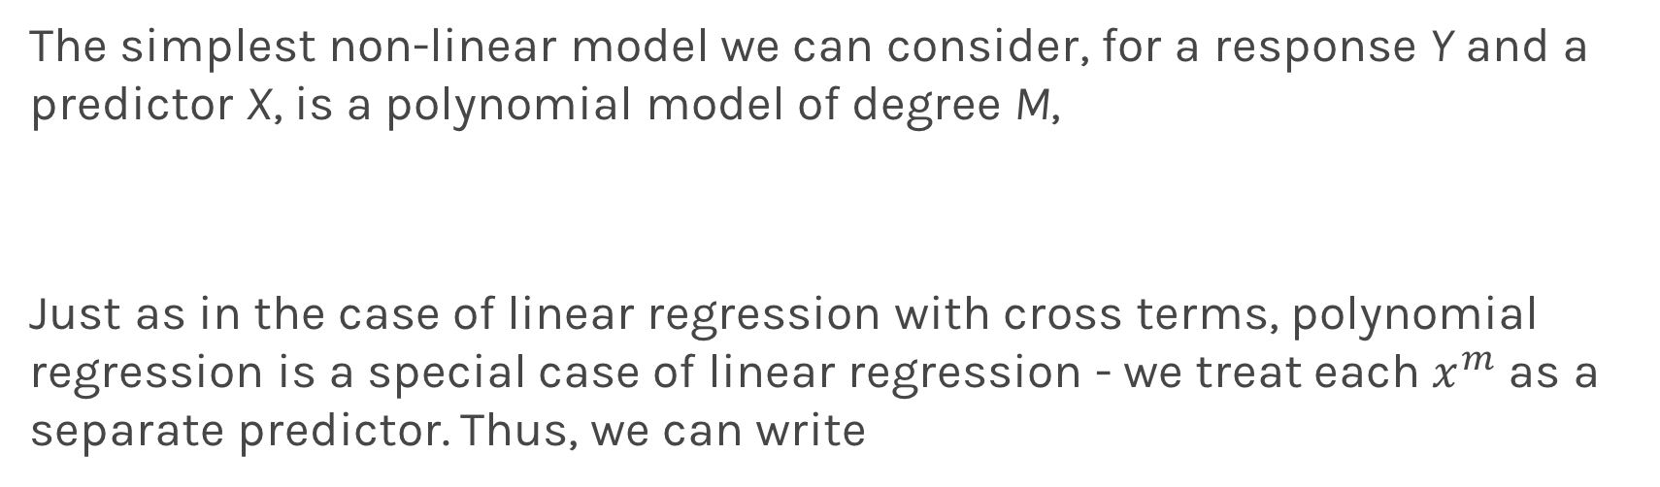
Polynomial Regression
The simplest non-linear model we can consider, for a response Y and a predictor X, is a polynomial model of degree M,
Just as in the case of linear regression with cross terms, polynomial regression is a special case of linear regression - we treat each $x^{m}$ as a separate predictor. Thus, we can write

Slide 50
Polynomial Regression
Again, minimizing the MSE using vector calculus yields,

